Slide 1
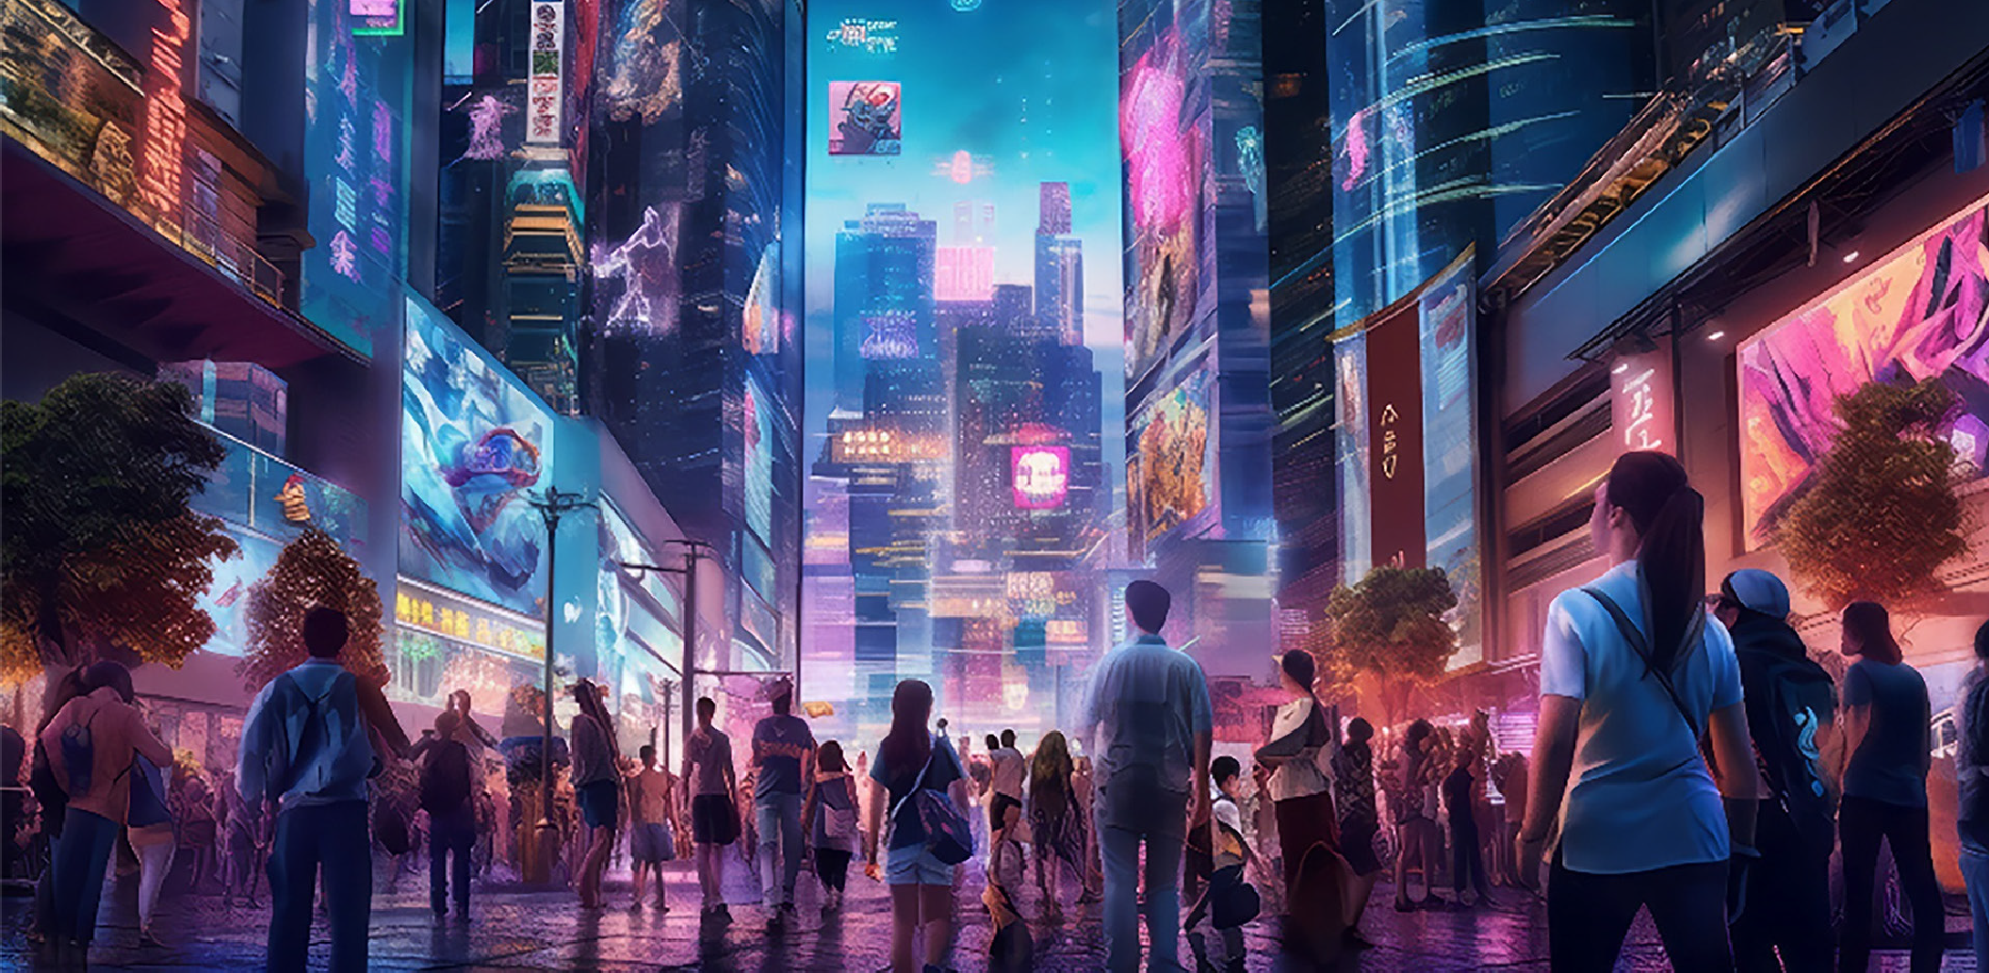


Global Initiative on AI and Virtual Worlds - Discovering the Citiverse
The AI-Enabled Citiverse
A Strategic Blueprint for Cities in the Age of AI
15 June 2026
Teppo Rantanen, Leader of Strategic Guidance Track

Slide 2






Global Initiative on AI and Virtual Worlds – Discovering the Citiverse
Five Forces Reshaping Cities
Converging pressures demand a new kind of urban intelligence.
Maturation of AI
Economic Restructuring
Governance Complexity
Autonomous reasoning reshapes every public service.
Digital competitiveness is now a prerequisite.
Cross-sector coordination demands new tools.
Shifting Citizen Expectations
Climate Volatility
Residents demand hyper-personalized services.
Anticipatory planning is now essential.
Cities must redesign as intelligent, anticipatory systems.

Slide 3
Global Initiative on AI and Virtual Worlds – Discovering the Citiverse
THE STRATEGIC SHIFT
From Infrastructure to Human Potential
Then: Optimizing Infrastructure
Now: Optimizing Human Potential
Roads, grids, transit
Essential, but no longer sufficient
Strategic foresight
Risk-free simulation
Evidence-based policymaking
Citizens at the center

Slide 4



Global Initiative on AI and Virtual Worlds – Discovering the Citiverse
Decoding the Frontier
From Technologies to Civic Capabilities
Virtual worlds
Artificial intelligence
Enabling immersive environments
Enabling reasoning and autonomy
Immersive data
Spatial collaboration
Predictive intelligence
Autonomous response
Digital twins
Data foundations
Enabling systems intelligence
Enabling AI sovereignty
System simulation
Policy foresight
Secure infrastructure
Data sovereignty

Slide 5

Global Initiative on AI and Virtual Worlds – Discovering the Citiverse
Human-Centered by Design
The true measure is not technological sophistication — it is human empowerment.
Inclusive Access
Human-Level Intelligence
Workforce Augmentation
City services through natural language. No resident left behind.
AI that addresses complex, nuanced challenges with depth and empathy.
Elevating city employees, not replacing them.

Slide 6
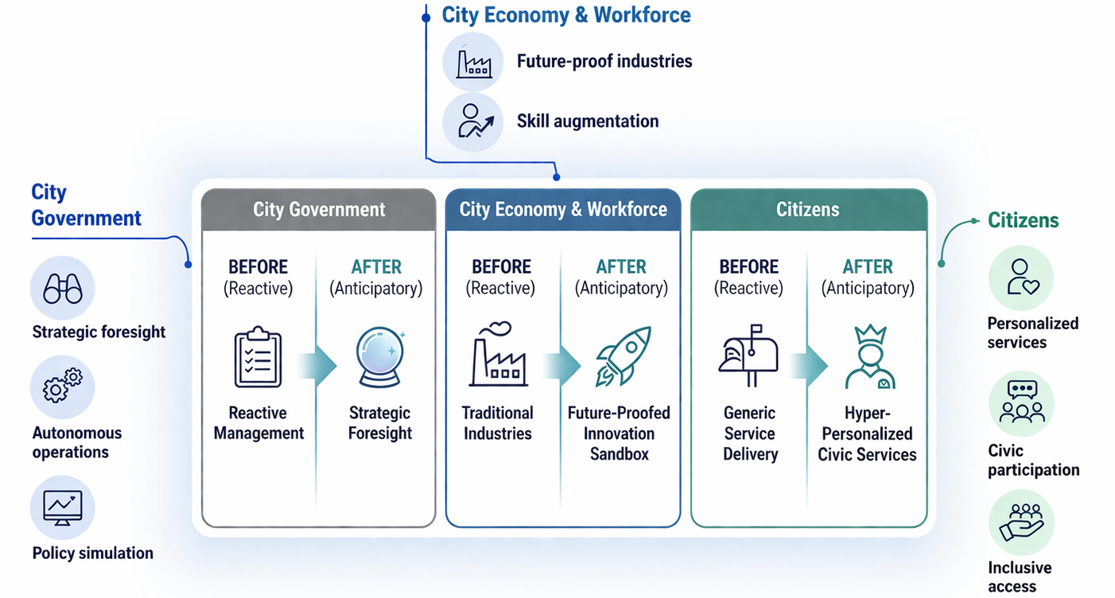
Global Initiative on AI and Virtual Worlds – Discovering the Citiverse
Building the AI-Enabled Citiverse Ecosystem for Cities

Slide 7

Global Initiative on AI and Virtual Worlds – Discovering the Citiverse
Built for Every City. Shaped by Local Priorities.
No universal blueprint. One shared architecture. Infinite local expression.
Build for Scalable Sovereignty
Align with Civic Mandates
Diagnose Local Needs
Own your data. Avoid lock-in. Grow on your terms.
Embed vision within political and community commitments.
Start with community data, not imported assumptions.

Slide 8

Global Initiative on AI and Virtual Worlds – Discovering the Citiverse
The Window Is Open. Act Now.
Cities that move in the next 24 months will define the standards for a generation.
68%
2030
70%
of global GDP generated by cities. Urban AI is an economic imperative.
UN SDG deadline. Cities must dramatically accelerate innovation.
of humanity will live in cities by 2050. Scale intelligence before demand overwhelms capacity.

Slide 9
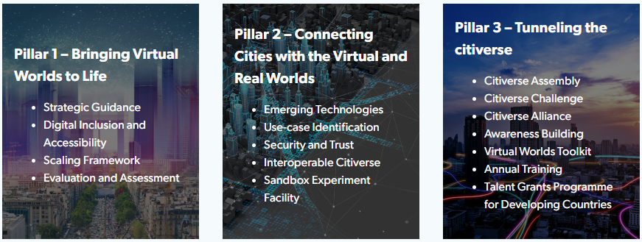
Global Initiative on AI and Virtual Worlds – Discovering the Citiverse
Global Initiative on AI and Virtual Worlds
Discovering the Citiverse
A growing multistakeholder coalition of 70+ partners

Slide 10
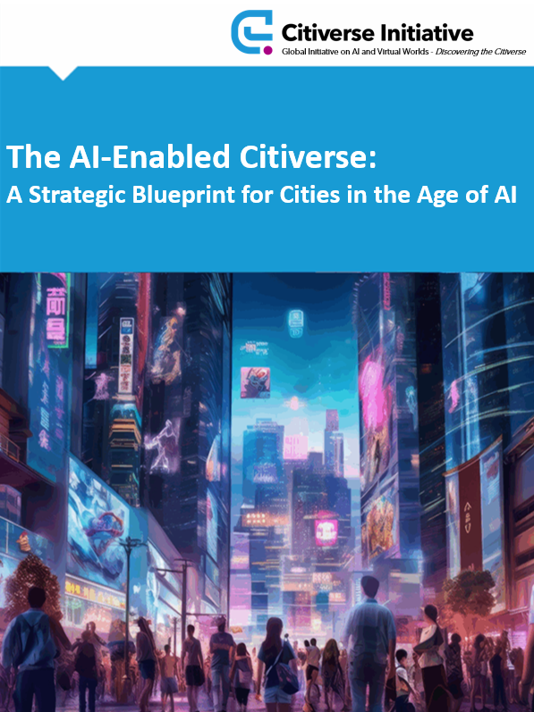



Global Initiative on AI and Virtual Worlds – Discovering the Citiverse
Global Initiative on AI and Virtual Worlds — Discovering the Citiverse
This deliverable was led and coordinated by Teppo Rantanen (City of Tampere, Finland) and Okan Geray
(Dubai Digital Authority).
The deliverable is based on the contribution, support and participation of Sanni Pöntinen (Tampere University), Masoumeh Salimi (City of Tampere), Petri Takala (Capgemini), Hans Teuben (Capgemini), Christina Yan Zhang (The Metaverse Institute), Bas Boorsma (Urban Innovators Global), Roland van der Heijden (City of Rotterdam), Arturo Castellas (City of Valencia) and Ravi Shankar (Capgemini).
The authors extend their sincere thanks to the Executive Committee of the Global Initiative on AI and Virtual Worlds: H.E. Mr Hamad Al Mansoori (Director General, Digital Dubai), H.E. Ms Angellah Jasmine Mbelwa Kairuki (Ministry of Information, Communication and Information Technology, Tanzania), H.E. Mr William Kabogo Gitau (Ministry of Information, Communications and the Digital Economy, Kenya), Felipe Fernando Macías Olvera (Municipality of Queretaro, Mexico), Manuel Barreiro (Aston Group), Karl-Filip Coenegrachts (Open & Agile Smart Cities (OASC)), Hyoung Jun Kim (ITU-T Study Group 20 “Internet of Things, digital twins and smart sustainable cities and communities”), Jaakko Mustakallio (City of Tampere, Finland), Paula Llobet Vilarrasa (City of Valencia, Spain), Sameer Chauhan (United Nations International Computing Centre (UNICC)) and Jeong Kee Kim (World Smart Sustainable Cities Organization (WeGO)).
The authors also thank the Steering Committee of the Global Initiative on AI and Virtual Worlds for their continued support: Bertrand Levy, Paola Cecchi Dimeglio (Harvard University), Ernesto Faubel (European Digital Infrastructure Consortium (EDIC) on Local Digital Twins), Martin Brynskov (OASC), Anish Sethi (UNICC), AnaMaria Meshkurti (AMVS Capital) and Roland van der Heijden (City of Rotterdam, The Netherlands).
The authors also extend their gratitude to the contributing organizations along with their representatives: Cristina Bueti, Yining Zhao, Chiara Co (ITU) and Franca Vinci (UNICC).

Slide 11


Global Initiative on AI and Virtual Worlds – Discovering the Citiverse
Architecting Tomorrow. Today.
Bold vision. Disciplined execution. Human impact.
Govern & Evolve
Pilot & Learn
Assess & Align
Scale & Integrate
Launch pilots, measure human impact
Institutionalize AI governance, adapt continually
Diagnose needs, align with civic mandates
Expand across systems, build data foundations
Let's build the future we want — together.
Join 70+ partners in the Global Initiative. Build the intelligent, human-centered city of tomorrow.

Slide 12
Global Initiative on AI and Virtual Worlds - Discovering the Citiverse
Thank you!
virtualworlds@itu.int
itu.int/metaverse/virtual-worlds/

