Slide 1



Global Initiative on AI and Virtual Worlds - Discovering the Citiverse
City Leader’s Field Guide:
Preparing for the AI-Enabled Citiverse
The Practical Readiness Assessment for Mayors, Ministers, and Senior City Decision-Makers
Dr Christina Yan Zhang, Leader, Track 5, Evaluation and Assessment Framework
15 June 2026

Slide 2




Global Initiative on AI and Virtual Worlds – Discovering the Citiverse
What is the AI-Enabled Citiverse?
The convergence of AI, digital twins, spatial computing, and immersive environments into a coherent, sovereign, human-centric urban intelligence platform — designed to serve human potential, not replace it.
Robust Data Foundations & AI Governance
Virtual Worlds & Immersive Environments
AI Reasoning & Autonomy
Digital Twins & Systems Intelligence
Turn complex urban data into immersive, participatory experiences for collaborative city design.
Transform static urban grids into cognitive networks that anticipate and adapt in real time.
Simulate policy and infrastructure impacts across the urban system before real-world implementation.
Build secure, federated data systems that ensure city-owned data control and power all capabilities.

Slide 3





Global Initiative on AI and Virtual Worlds – Discovering the Citiverse
How to Use This Field Guide?
Three steps. No consultant required. Any city, any size, any budget.
Step 1 — Pulse Check
~20 min · Answer 12 Yes/No questions · Find your starting Tier (0–5)
· Identify your strategic focus
Step 2 — Essential 20 Assessment
2–4 hrs · Score 20 indicators (0–4) · Document evidence · Identify critical gaps
Step 3 — 90-Day Action Plan
Half-day workshop · Set priorities · Assign owners and budgets · Schedule first review
Gather at least three people: your digital lead, a finance representative, and a community or communications officer. This is your assessment team.

Slide 4






Global Initiative on AI and Virtual Worlds – Discovering the Citiverse
Step 1: The Pulse Check — 12 Domains (1)
Answer Yes/No · Count your Yes answers · Find your Tier
Vision
Barriers
Use Cases
Does your city have a formally endorsed policy or strategy for the AI-enabled Citiverse, digital twins, or AI-powered virtual services, linked to your existing strategic plan?
Has your city evaluated its organisational culture and readiness for AI-enabled Citiverse digital transformation and identified who will champion and who may resist?
Has your city identified at least one high-priority urban problem the AI-enabled Citiverse will specifically address with a concrete use case and a line of sight to economic opportunity or citizen benefit?
Governance
AI Governance ★
Technology
Are your legal and regulatory compliance risks for digital transformation regularly reviewed and are existing laws that could block or delay deployment identified?
Does your city have formal principles or policies governing the use of AI covering transparency, accountability, explainability, human oversight, and bias prevention in public services?
Does your city have digital twin systems or a live, data-connected virtual representation of city infrastructure currently implemented or actively piloted?

Slide 5






Global Initiative on AI and Virtual Worlds – Discovering the Citiverse
Step 1: The Pulse Check — 12 Domains (2)
Answer Yes/No · Count your Yes answers · Find your Tier
Privacy
Security
Inclusion
Are robust citizen-centred privacy, consent, and data sovereignty mechanisms integrated into your digital services with clear opt-in/opt-out mechanisms for citizens?
Does your city maintain a regularly updated risk register covering safety, privacy, operational, financial, and reputational risks for all digital initiatives?
Are inclusive design principles applied to ensure digital and physical accessibility for all citizens, especially people with disabilities and those with limited digital literacy?
Finance
Partners
Impact
Has a multi-year budget been identified covering not just the initial build, but the long-term maintenance, operation, and continuous improvement of the system?
Are all key stakeholders identified – academia, private sector, NGOs, communities – and are structured engagement strategies in place for each?
Are social, economic, and environmental impacts of your digital initiatives regularly assessed and is there a mechanism to measure whether technology is narrowing or widening inequality?

Slide 6
Global Initiative on AI and Virtual Worlds – Discovering the Citiverse
Step 1: Result — Your City's Tier
Count your Yes answers — each tier has one key objective before advancing
TIER 0
The Coalition
TIER 1
The Why
0–3
Key objective: Build relationships
4–5
Key objective: Formalise your vision
Find your champions and those who will resist. Write a one-paragraph “why this matters” statement for your city. No document is more valuable than this.
Draft a one-page statement of intent and identify three high-value use cases that match your city's most urgent civic challenges.
YES
YES
TIER 2
The How
TIER 3
The Pilot
6–7
Key objective: Clear your path
8–9
Key objective: Build and launch
Audit legal barriers, governance gaps, and AI governance readiness. Secure seed funding for a 90-day pilot.
Deploy core infrastructure, train your team, and run a minimal viable prototype for one use case.
YES
YES
TIER 4
The Scale
TIER 5
The Legacy
10–11
Key objective: Harden and grow
12
Key objective: Measure and sustain
Formalise security, trust, AI governance safeguards, and adoption campaigns for city-wide rollout.
Audit universal access, publish impact and equity data, and share your model globally with peer cities.
YES
YES

Slide 7
Global Initiative on AI and Virtual Worlds – Discovering the Citiverse
Step 2: The Essential 20 Assessment
Score 20 indicators across 12 domains — document evidence for each
SCORING SCALE
12 DOMAINS ASSESSED
0
Absent / Ad hoc
Vision (D1)
Barriers (D2)
Non-existent or entirely reactive. No plans in place. High implementation risk.
1
Use Cases (D3)
Governance (D4)
Aware / Exploring
AI Governance ★ (D5)
Technology (D6)
Recognised as needed. Early discussions underway. No formal commitment yet.
Privacy (D7)
Security (D8)
2
Defining / Developing
Inclusion (D9)
Finance (D10)
Formal processes being created – a draft under review, a pilot under design. Moderate risk.
Partners (D11)
Impact (D12)
3
Implemented / Operational
⚠ Any indicator scored 0 (Absent) is a showstopper. Address it before proceeding.
Formally established, funded, and in active use. Solid foundation. Low risk.
4
Any domain with an average below 1.5 represents a significant implementation risk.
Optimised / Embedded
Advanced, measured, and continuously improved. Strategic advantage.
✓ Indicators scored 3 or 4 are your strengths – leverage them to accelerate the initiative

Slide 8
Global Initiative on AI and Virtual Worlds – Discovering the Citiverse
Step 2: Result — Interpreting Your Score
0 – 20
Focus entirely on Vision (D1), Use Cases (D3), and Stakeholder Mapping (D12). Do not attempt technology deployment.
Critical Gaps
21 – 40
Prioritise Governance (D4) including AI Governance (D4-3) and Finance (D10). Lock in a PoC requirement before any procurement.
Foundation Building
41 – 60
Proceed with a 90-day pilot. Focus hardening on Security (D7), Privacy (D6), and AI Governance (D4-3).
Solid Platform
61 – 80
Invest in Inclusion (D8), Impact metrics (D14), and Investment Signal review (D10-2). Seek peer-city benchmarking.
Strong Readiness

Slide 9

Global Initiative on AI and Virtual Worlds – Discovering the Citiverse
Step 3: The 90-Day Action Plan
Turn your assessment into your first concrete actions.
THREE QUESTIONS BEFORE YOU BEGIN
PEOPLE
MONEY
PERMISSION
Who is the 'bus driver'?
What is the pilot budget?
Does the mayor say yes?
Name the individual responsible for this initiative's momentum.
The smallest non-disruptive budget for a 90-day experiment.
Explicit support from the mayor or deputy mayor for a sandbox.
FOCUS ON YOUR TIER — PRACTICAL FIRST ACTIONS
T0 (0-3)
Host informal conversations with 3 department heads. Map who will champion and who will block. Write a one-paragraph “why this matters” statement for your city.
T1 (4-5)
Draft a one-page statement of intent. List your top 5 urban problems and select one the AI-enabled Citiverse could address. Identify one university or NGO as a first partner.
T2 (6-7)
Commission a legal gap analysis. Draft AI governance principles covering transparency and human oversight. Identify a small, reallocation-based budget for a 90-day pilot.
T3 (8-9)
Set up the simplest possible cloud-based infrastructure for your use case. Train the core team (5–10 people). Implement basic data privacy safeguards. Define one citizen-facing success metric.
T4 (10-11)
Harden your cybersecurity strategy. Develop citizen trust protocols. Conduct a full AI governance audit before wider rollout. Launch adoption incentives and a public communications plan.
T5 (12)
Commission an independent social impact assessment. Audit all services for universal accessibility. Publish your ROI and equity data publicly. Share your model with peer cities through the Global Initiative.

Slide 10
Global Initiative on AI and Virtual Worlds – Discovering the Citiverse
Review Schedule & Go/No-Go Decisions
01
30 Days
Are all five actions in motion?
Has political commitment been confirmed in writing?
Progress on Action Plan items 1–5. Coalition status. Any blockers identified.
↓
60 Days
Is the pilot design approved?
Is the budget secured? Is the team in place?
02
Evidence collected for scored indicators. Pilot design confirmed.
↓
90 Days
Did the pilot deliver value?
If yes → plan to scale. If no → analyse and adapt.
03
Pilot outcomes against the citizen success metric defined at launch.
↓
12 Months
Has the total score improved?
Are critical 0-scored indicators now at 2+?
04
Full re-assessment of the Essential 20. Score comparison vs baseline.

Slide 11




Global Initiative on AI and Virtual Worlds – Discovering the Citiverse
Guiding Principles
Readiness Over Eagerness
Human-Centric by Design
Local Context Defines the Pathway
Your score is determined by your current, verified capabilities – not your future ambitions. An honest score of 1 is more valuable than an optimistic score of 3.
Technology is a means, not an end. Embed inclusion from Day 1. The Citiverse succeeds only when it serves human potential.
This framework is neutral. Your city's unique needs, priorities, and capacities interpret the results and shape your roadmap. There is no single correct AI-enabled Citiverse.
Evidence Over Opinion
Managed Progression
The 'Good Enough' Rule
Every score requires cited evidence. This transforms self-assessment into an auditable governance tool that attracts investment.
Build confidence by validating capabilities before advancing. A Tier 1 city that executes stage 1 faithfully will progress faster than a Tier 1 city that attempts stage 3 and fails.
You do not need perfection. You need progress. If even one indicator helps you deliver a better service to a single citizen, you have succeeded.

Slide 12
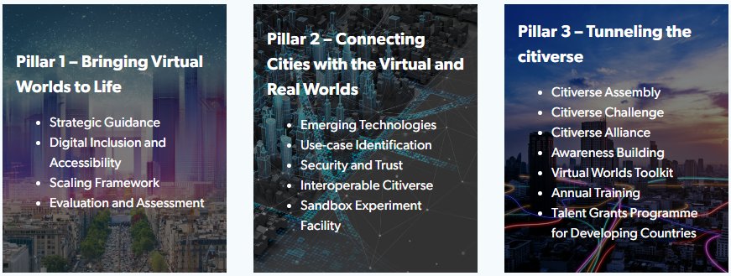
Global Initiative on AI and Virtual Worlds – Discovering the Citiverse
Global Initiative on AI and Virtual Worlds
Discovering the Citiverse
A growing multistakeholder coalition of 70+ partners

Slide 13

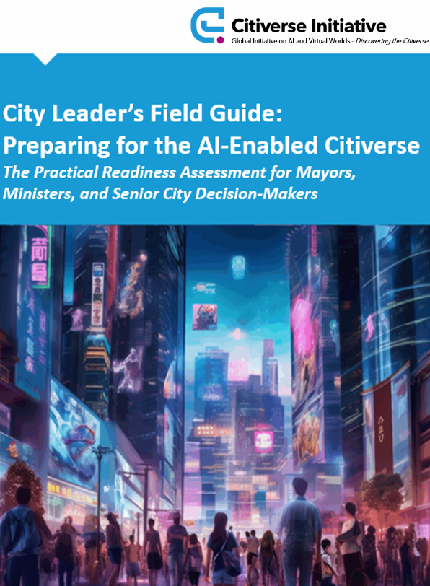


Global Initiative on AI and Virtual Worlds – Discovering the Citiverse
THE GLOBAL INITIATIVE — DISCOVERING THE CITIVERSE
This deliverable was led and coordinated by Christina Yan Zhang (The Metaverse Institute). Co-authored by Dino Cataldo Dell’Accio (United Nations Joint Staff Pension Fund)
The deliverable is based on the authorship, contribution, support and participation of Christina Yan Zhang (The Metaverse Institute), Dino Cataldo Dell’Accio (United Nations Joint Staff Pension Fund), Nicholas You (Guangzhou Institute of Urban Innovation), Karl-Filip Coenegrachts (Open & Agile Smart Cities), Ernesto Faubel (European Digital Infrastructure Consortium on Local Digital Twins on Citiverse), Bruno Lanvin (Smart City Observatory), Usha Hayes (UNICEF China), Wookyung Jung (INTERPOL), MD Khorshed Alam (UN Tourism), Jordi Vaquer (Metropolis- World Association of the Major Metropolises), Isaac Boateng and John Omo (African Telecommunication Union), John Wood(Attract Project), David Castle (University of Victoria and Office of the Chief Science Advisor, Canada), Madan Oberoi (Google), Corey Gray (Smart Cities Council), Ziad-Alexandre Hayek (World Association of PPP Units & Professionals (WAPPP)), Phil Allsopp (Royal Institute of British Architects), Erdem Samut (Istanbul Information and Smart City Technologies Company/Istanbul Metropolitan Municipality), Takehiko Nagumo (Smart City Institute Japan), Noor ul Owase Jeelani(Great Ormond Street Hospital), Laurence Moroney (Arm), Martin Visbeck (OceanQuest), Alvin Wang Graylin (Virtual World Society), Hema Sridhar (Koi Tū Centre for Informed Futures), Ghassan Aouad (Abu Dhabi University), Cristina Garrido (Anteverti), Rafael Escalona Reynoso (Portulans Institute), Andras Szorenyi (Global Cities Hub), Hend Alhazzani (Public Investment Fund, Kingdom of Saudi Arabia).
The authors extend their sincere thanks to the Executive Committee of the Global Initiative on AI and Virtual Worlds: H.E. Mr Hamad Al Mansoori (Director General, Digital Dubai), H.E. Ms Angellah Jasmine Mbelwa Kairuki (Ministry of Information, Communication and Information Technology, Tanzania), H.E. Mr William Kabogo Gitau (Ministry of Information, Communications and the Digital Economy, Kenya), Felipe Fernando Macías Olvera (Municipality of Queretaro, Mexico), Manuel Barreiro (Aston Group), Karl-Filip Coenegrachts (Open & Agile Smart Cities (OASC)), Hyoung Jun Kim (ITU-T Study Group 20 “Internet of Things, digital twins and smart sustainable cities and communities”), Jaakko Mustakallio (City of Tampere, Finland), Paula Llobet Vilarrasa (City of Valencia, Spain), Sameer Chauhan (United Nations International Computing Centre (UNICC)) and Jeong Kee Kim (World Smart Sustainable Cities Organization (WeGO))
The authors also thank the Steering Committee of the Global Initiative on AI and Virtual Worlds for their continued support: Okan Geray (Digital Dubai), Bertrand Levy, Paola Cecchi Dimeglio (Harvard University), Ernesto Faubel (European Digital Infrastructure Consortium (EDIC) on Local Digital Twins), Martin Brynskov (OASC), Anish Sethi (UNICC), AnaMaria Meshkurti (AMVS Capital) and Roland van der Heijden (City of Rotterdam, The Netherlands).
The authors also extend their gratitude to the Cristina Bueti, Yining Zhao, Chiara Co (ITU) and Franca Vinci (UNICC).

Slide 14
Global Initiative on AI and Virtual Worlds - Discovering the Citiverse
Thank you!
virtualworlds@itu.int
itu.int/metaverse/virtual-worlds/

