Slide 1
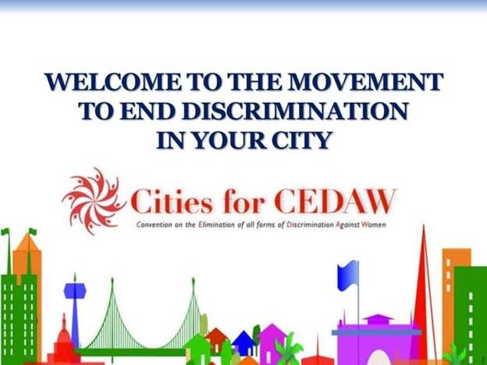
Connecting Global to Local is a two-way process
The Cities for CEDAW campaign can bring its innovation and leadership to the international arena.
international feminist and women’s movements can benefit from the experiences of the Cities for CEDAW campaign.

Slide 2

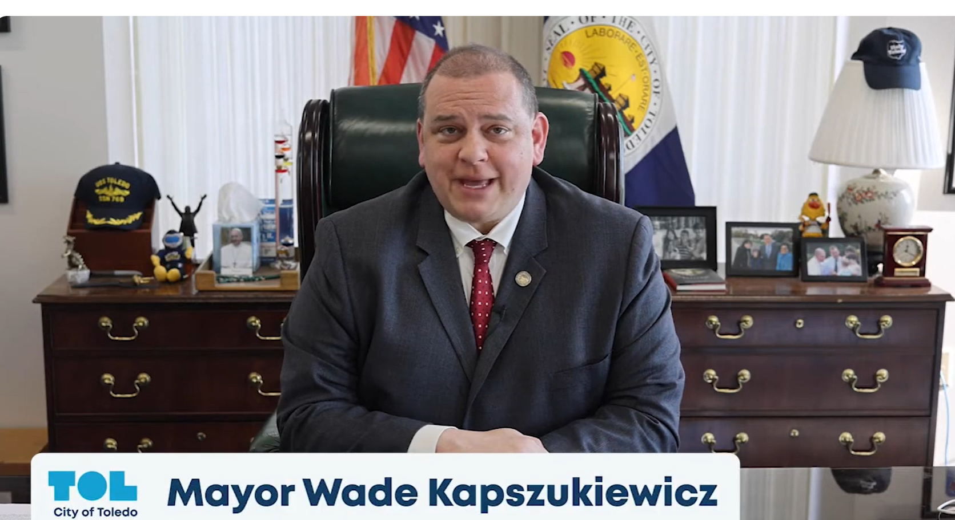
Steps to make CEDAW a local reality
Assess: baseline data across all departments
Public education/hearings and coalition building with diverse groups (labor unions, teachers, youth and media) before legislation
Work inside government: Male mayors and City Councils can be CEDAW champions of change and take the CEDAW Challenge

Slide 3
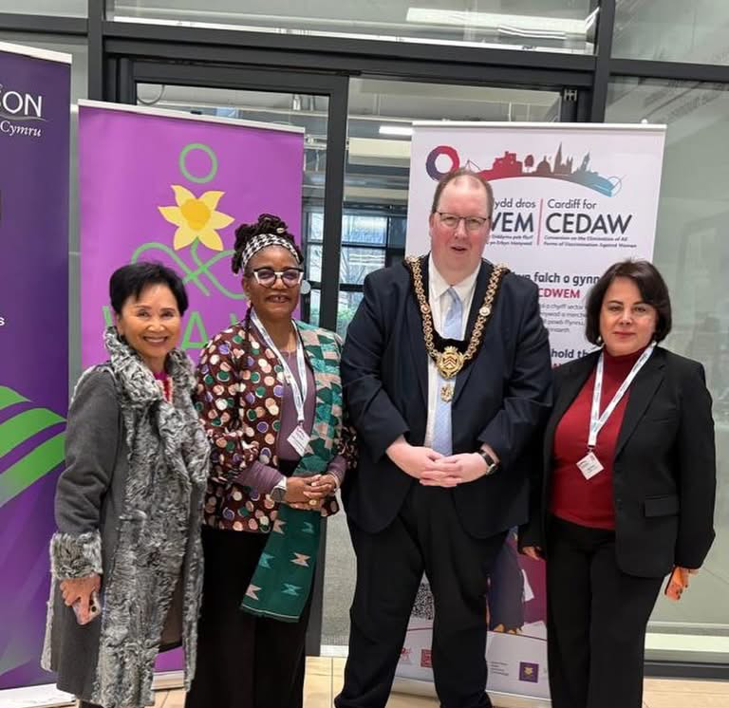
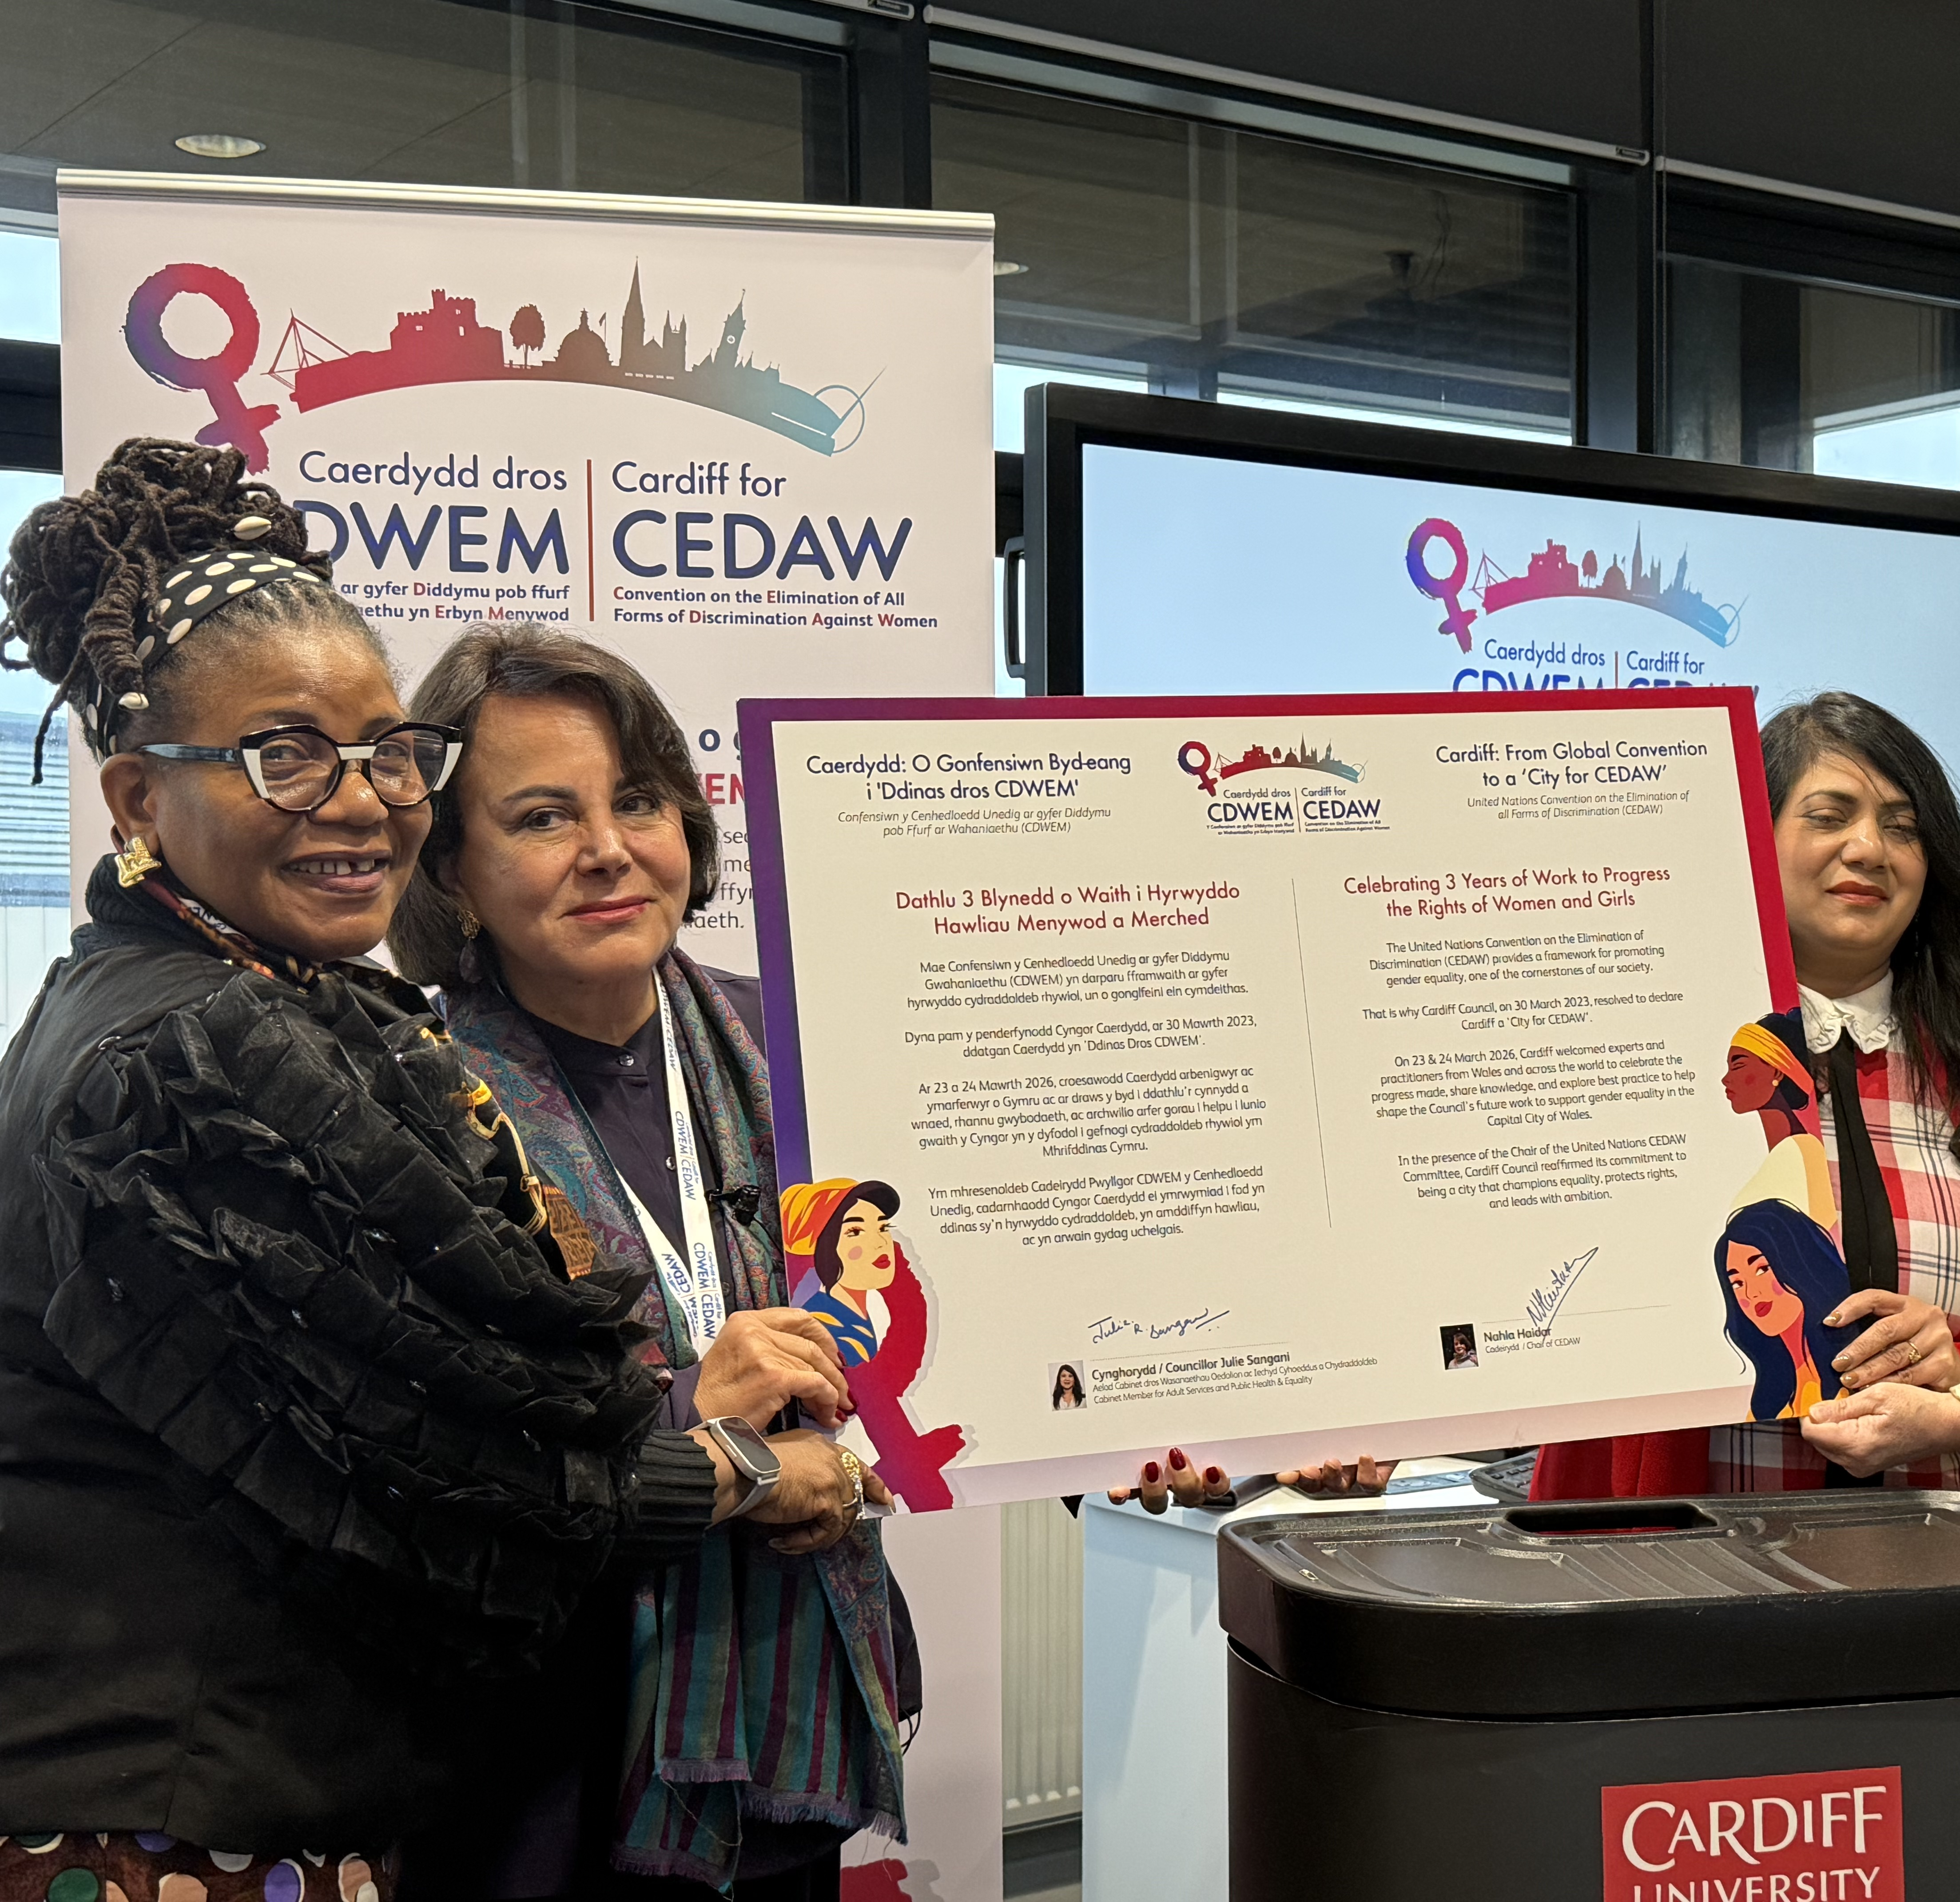
Cardiff, Wales, first CEDAW city in Europe

Slide 4
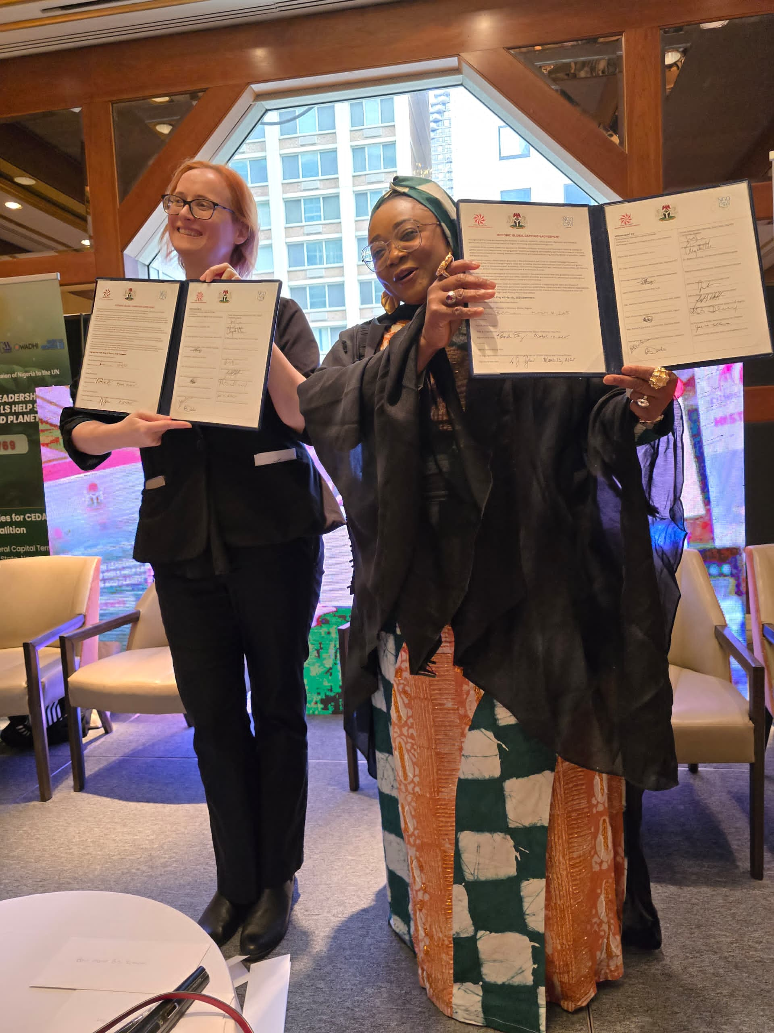
Strategies to Change Political Culture
Counties and States can use levers to change social norms
and political culture in other places
Connect with other CEDAW cities, sister cities
Participate in UN processes: local VNR (e.g. Amman) for HLPF, Join UN Habitat World Urban Forums

Slide 5

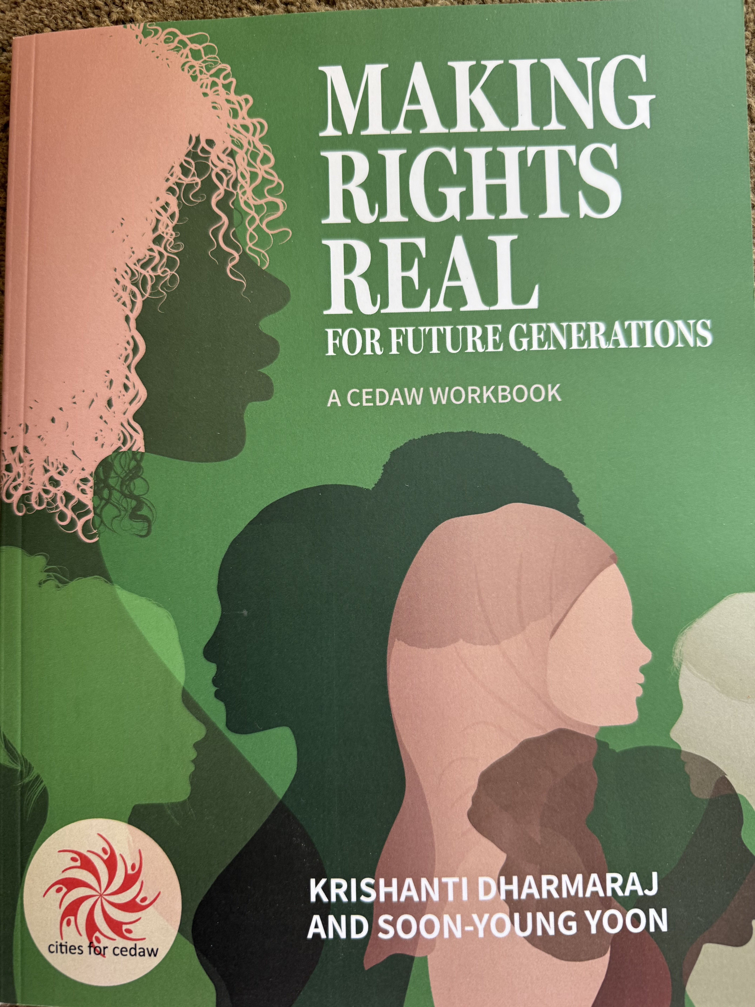
Resources
www.citiesforcedaw.org
https://cedawrising.org
Contact the Cities for CEDAW History and Futures Project: cities4cedaw@gmail.com

