Slide 1
CITIES FOR CEDAW
ADVANCING CEDAW AS A CATALYST FOR GROWTH
AT THE CITY AND LOCAL GOVERNMENT LEVEL
Esther Eghobamien-Mshelia | FP GBHR, CEDAW Committee
31 March 2026 · 15:00–16:00 CEST · Online

Slide 2
WHAT IS CEDAW?
The World's Most Comprehensive Human Rights Treaty for Women
189
1979
30+
States Parties
Adopted
Articles
Countries bound by treaty
Over 45 years of progress
Addressing all rights spheres
CEDAW IS THE ONLY BINDING TREATY ON WOMEN’S RIGHTS – CEDAW@45 Post Ratification Campaign launched
CEDAW defines discrimination against women, sets binding obligations for States to eliminate it, and creates an international monitoring system making it the most comprehensive human rights instrument for women's equality. CEDAW as of today is firm catalyst for growth.
BY 2026: 99% countries have constitutional equality provisions, but NO COUNTRY HAS ACHIEVED EQUALITY
By 2050, nearly 70% of people will live in cities — making local CEDAW implementation more urgent than ever.

Slide 3
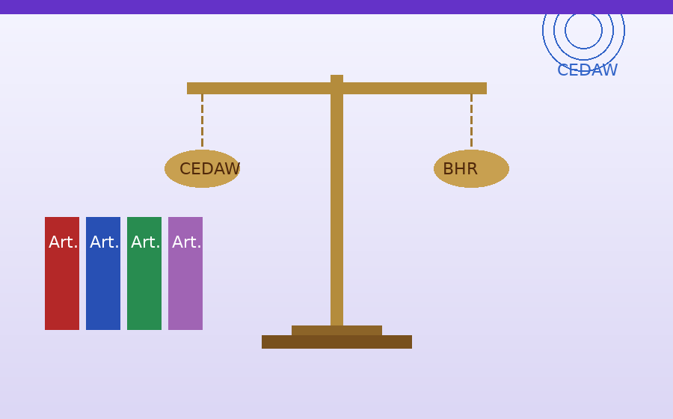
THE CEDAW NORMATIVE FRAMEWORK
Key Articles & General Recommendations Applicable to Cardiff's Business & Human Rights Context
Art. 2
Art. 3 & 5
Art. 7 & 8
Art. 11
Non-Discrimination & State Obligations
Equality & Dignity
Political & Public Participation
Employment & Economic Rights
States must pursue, by all appropriate means, a policy of eliminating discrimination against women — including in business regulation, corporate law, and economic governance in the City, LG, Nation
Full development of women in political, social and economic fields; elimination of stereotyped gender roles including in corporate governance, boardrooms, and hiring practices.
Equal participation in public life and government policy — including Wales's first female First Minister (2024), but persistent gaps remain across Cardiff's private sector leadership.
Equal pay, equal employment rights, prohibition of dismissal on grounds of maternity — directly applicable to all-employee gender pay gap contributes to revaluing & visibilizing women’s work.
GR &
Art.
Art. 13
GR 36
GR 40
Economic & Social Life
Right of girls and women to education
Gender-Balanced Leadership
Equal access to financial credit, bank loans, and mortgages — critical for women entrepreneurs in Cardiff's growing fintech and SME ecosystem under CEDAW.
Urges all states to eliminate gender stereotyping, address intersecting forms of discrimination, and ensure equal access to quality inclusive education at all levels.
Temporary special measures — quotas, pipelines, sponsorship — to achieve parity in corporate boards, public institutions, and senior management roles in at Local levels.
APPLICATION OF CEDAW AS A GROWTH CATALYST | CARDIFF | SLIDE 3

Slide 4
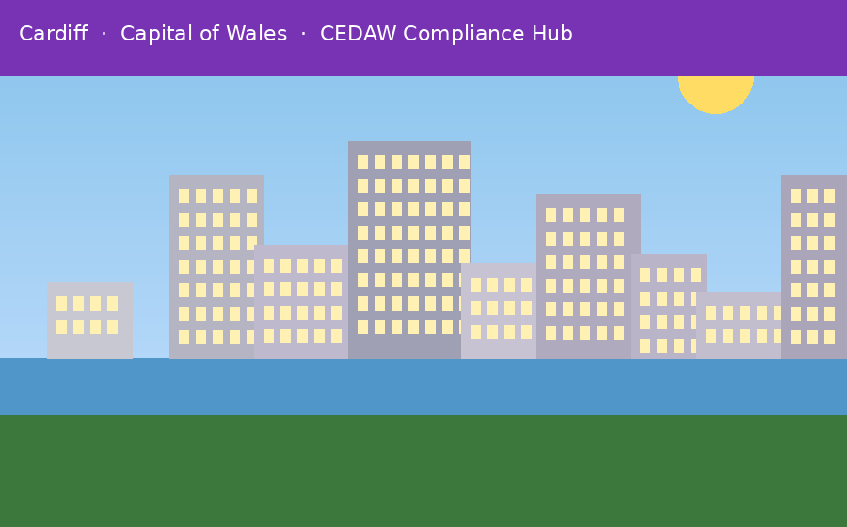
CONTEXT AND BACKGROUND
⚖ CEDAW as a Legal Catalyst
📈 Economic Context
Binding obligations on States to eliminate discrimination in business, finance, and economic participation — including in growing services, tech, and public administration sectors in Cities, LG & Municipalities.
Gender monopoly of Financial sector, Procurement Thus women earn significantly less overall and are over-represented in low-paid sectors — a direct CEDAW compliance failure.
Sept. 2023
OHCHR/CEDAW EXPERT GP MTG on LGs & HR Mechanisms Geneva event
92ND CEDAW SESSION Feb 2024
CITIES FOR CEADW AND FUTURE PROJECTS DIALOUGE WITH CEDAW COMMITEE
🤝 Business & Human Rights Nexus
🌱 Growth Through Equality
UN Guiding Principles on BHR require businesses to respect, protect, and remedy gender-based harms. CEDAW strengthens this with enforceable State obligations and Committee oversight.
Full gender parity could add to global &City economies. Path to sustainable growth runs through equitable labour markets and CEDAW compliance.
2025 CSW69
NIGERIA BECOMES FIRST COUNTRY TO ADOPT CITIES FOR CEDAW GLOBALLLY
2026
CSW70: L/A COUNCIL AWARD
CARDIFF-: 1st CITY for CEDAW in EUROPE
APPLICATION OF CEDAW AS A GROWTH CATALYST | CARDIFF | SLIDE 2

Slide 5
LESSONS & FUTURE PATHWAYS
Lessons learned from CEDAW Committee periodic reviews : SAMOA, SPAIN, MAURITANIA, CZECH
LESSONS LEARNT AND GAPS
PROSPECT FOR THE FUTURE
Limited CEDAW knowledge among local officials
Engage CEDAW as direct engagement model for local accountability & impact
No local redress mechanisms for discriminatory practices
Adopt local CEDAW ordinances (LA/San Francisco model/Nigeria/Cardiff)
Weak dissemination of Committee recommendations
Build local redress & accountability mechanisms; GBV safe spaces & delivery of UNSCR1325
Insufficient resources & capacity in LG departments
Mainstream gender across all LG departments with budgets & career-linked performance monitoring indicators
Unclear gender mainstreaming responsibility & budgets
Partner with women's CSOs & the Private Sectorfor transformatory, inclusive and substantive equality

Slide 6
LOCAL GOVERNMENTS: THE GREATEST THEATRE
Where CEDAW must be realized at community level
Duty Bearer & Regulator
Service Provider
Decentralized policy maker — ensuring constitutional and legislative protections reach every community
Schools, health centres, markets, land, agriculture, infrastructure — where women's daily rights are won or lost
Peace & Security Anchor
Political Grooming Ground
Frontline respondent to crisis, GBV, and emergencies — local safe spaces are a CEDAW obligation (Arts. 5 & 13, 14,15&16)
LGs build followership and leadership pipelines — India's Panchayat model proves the transformative potential
"LGs are the command theatres where the goal of eliminating discrimination must be realized."

Slide 7
KEY CEDAW ARTICLES FOR CITIES AND LOCAL LEVEL
Art. 3
National Machineries
Art. 5
Ending Violence & Trafficking
Art. 7
Participation & Leadership
Gender mainstreaming in local governance structures and budgeting
Safe communities, GBV response, dismantling harmful stereotypes
Equal representation in local governance and decision-making
Art. 11
Employment Rights
Art. 13
Socio-Economic Rights
Art. 14
Rural Women
Equal pay, non-discrimination, maternity protection locally
Access to credit, markets, social benefits — especially for rural women
Priority investment in rural development aligned with the SDGs
Together these articles form the normative foundation for city-level accountability to women's rights.

Slide 8
KEY TAKEAWAYS
CITIES FOR CEDAW
1. Provide binding legal architecture for gender equality in business environment thatcan be cascaded to local levels
Adopt a local CEDAW ORDINANCE/EDICT/BYE-LAW in your city/LG or Municipality as aninclusivegrowth model
3. Engage women's CSOs at the grassroots level & the PSector
4. Deploy Gender parity as an economic multiplier
UN-CEDAW COMMITTEE ; Global Cities Hub · Geneva Human Rights Hub · Human Rights Cities Network · Cities for CEDAW History & Futures Project

