Slide 1
LOCAL LEADERSHIP ON WATER RESILIENCE
Cllr Zahid Badroodien
Member of the Mayoral Committee - Water and Sanitation
23 March 2026

Slide 2
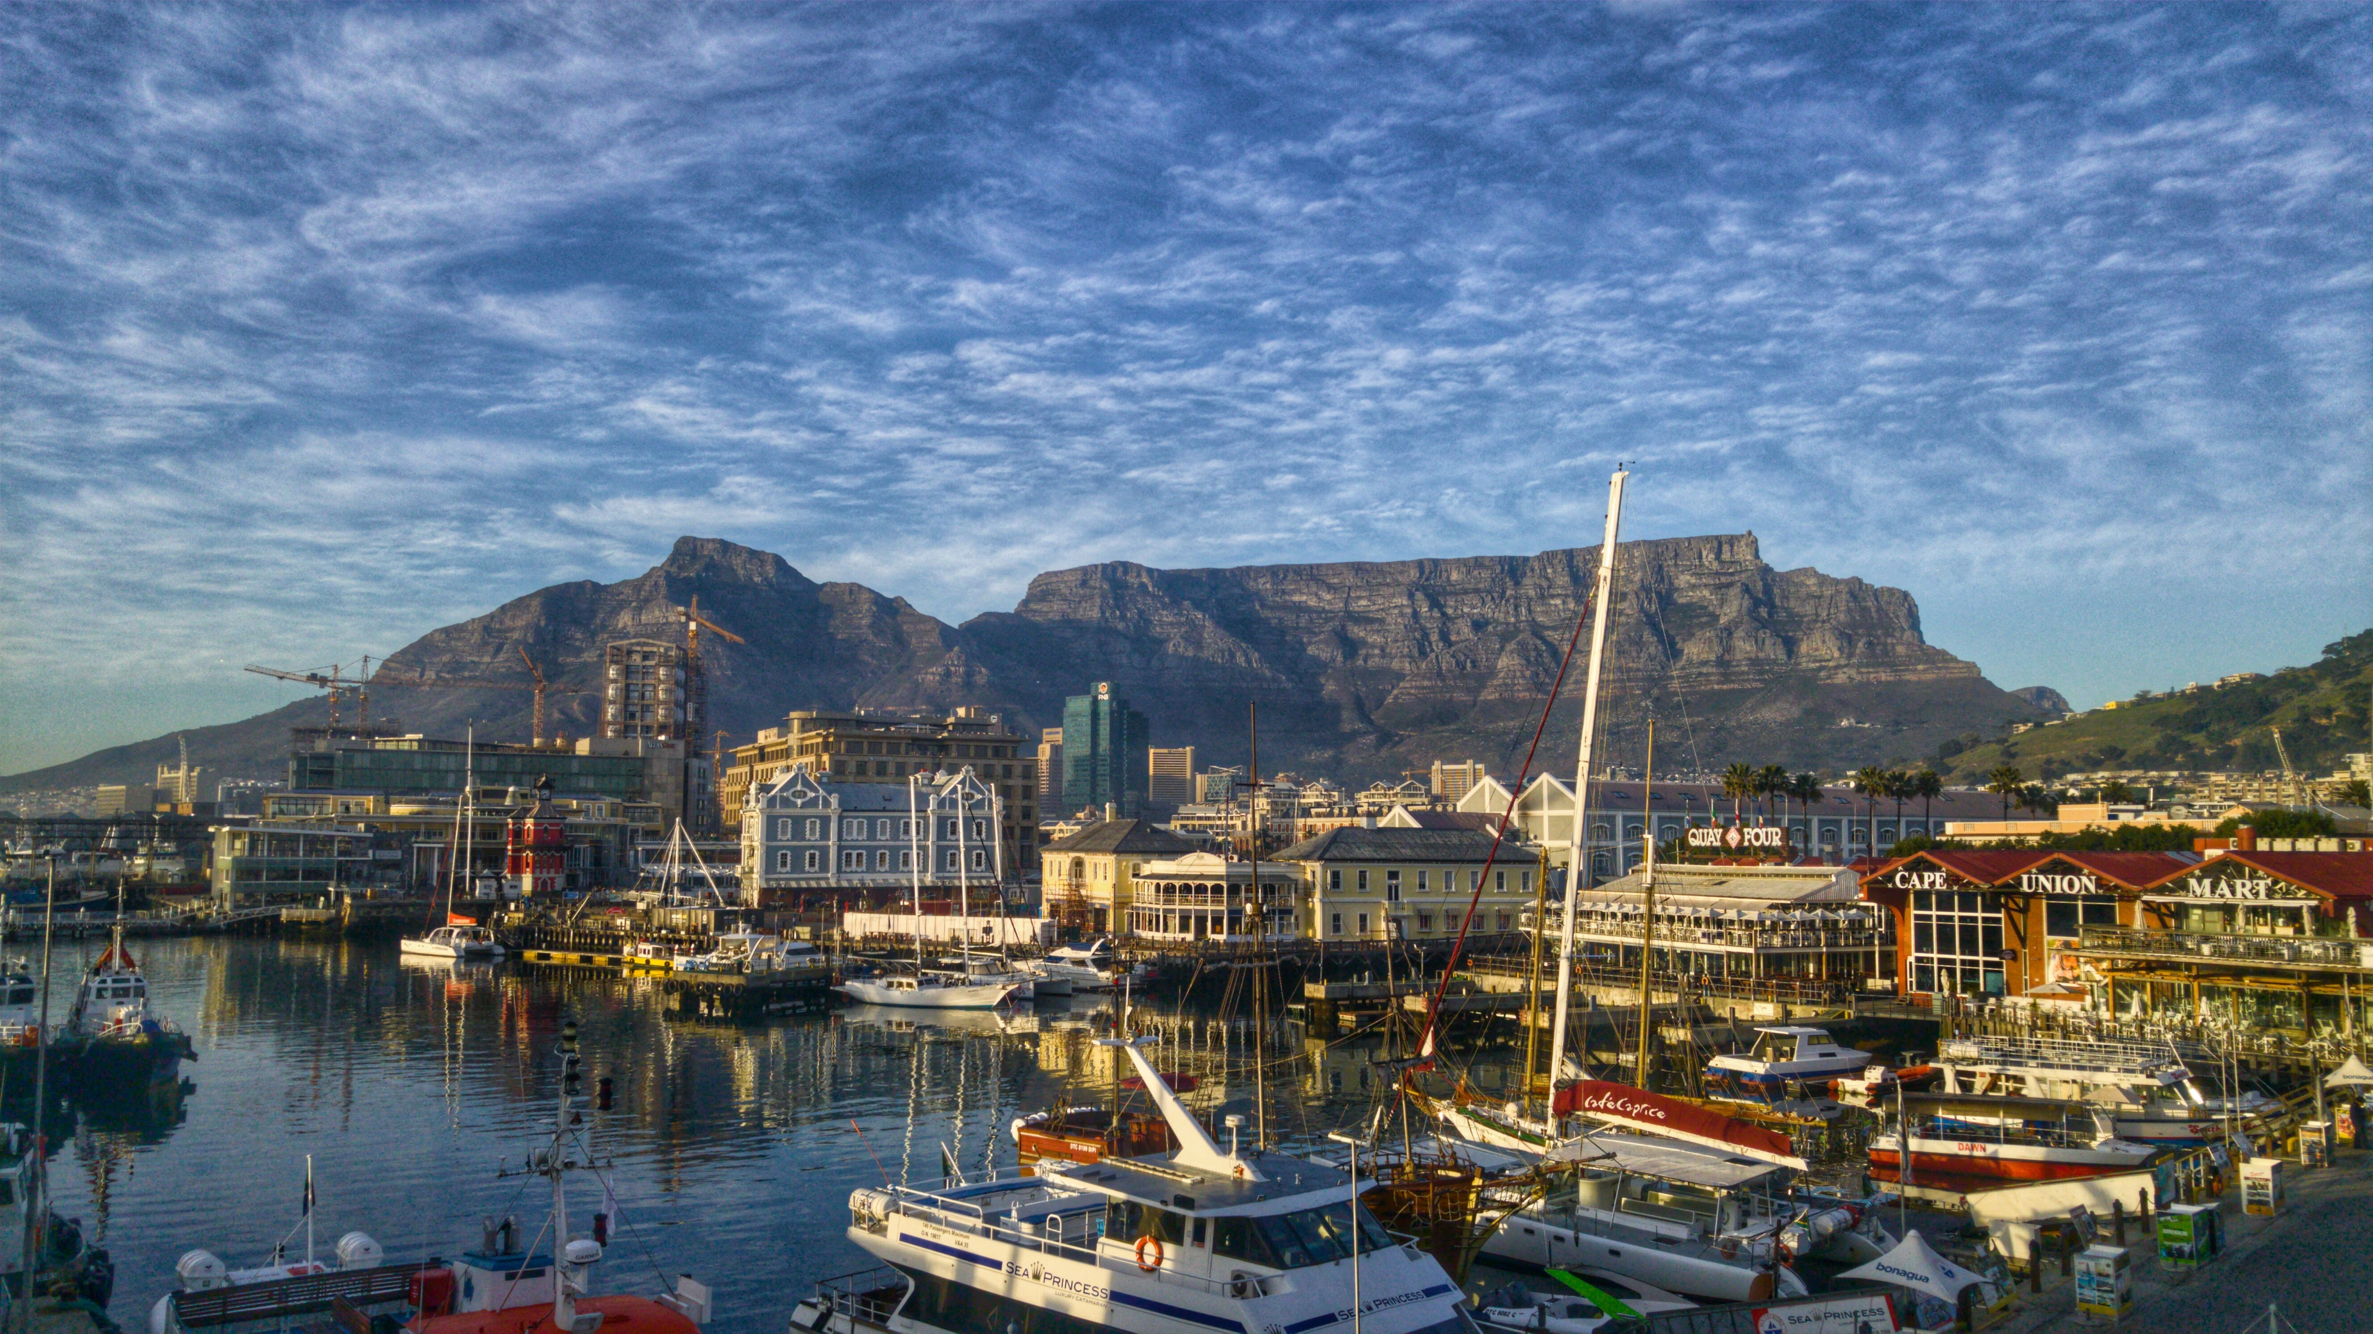

Slide 3
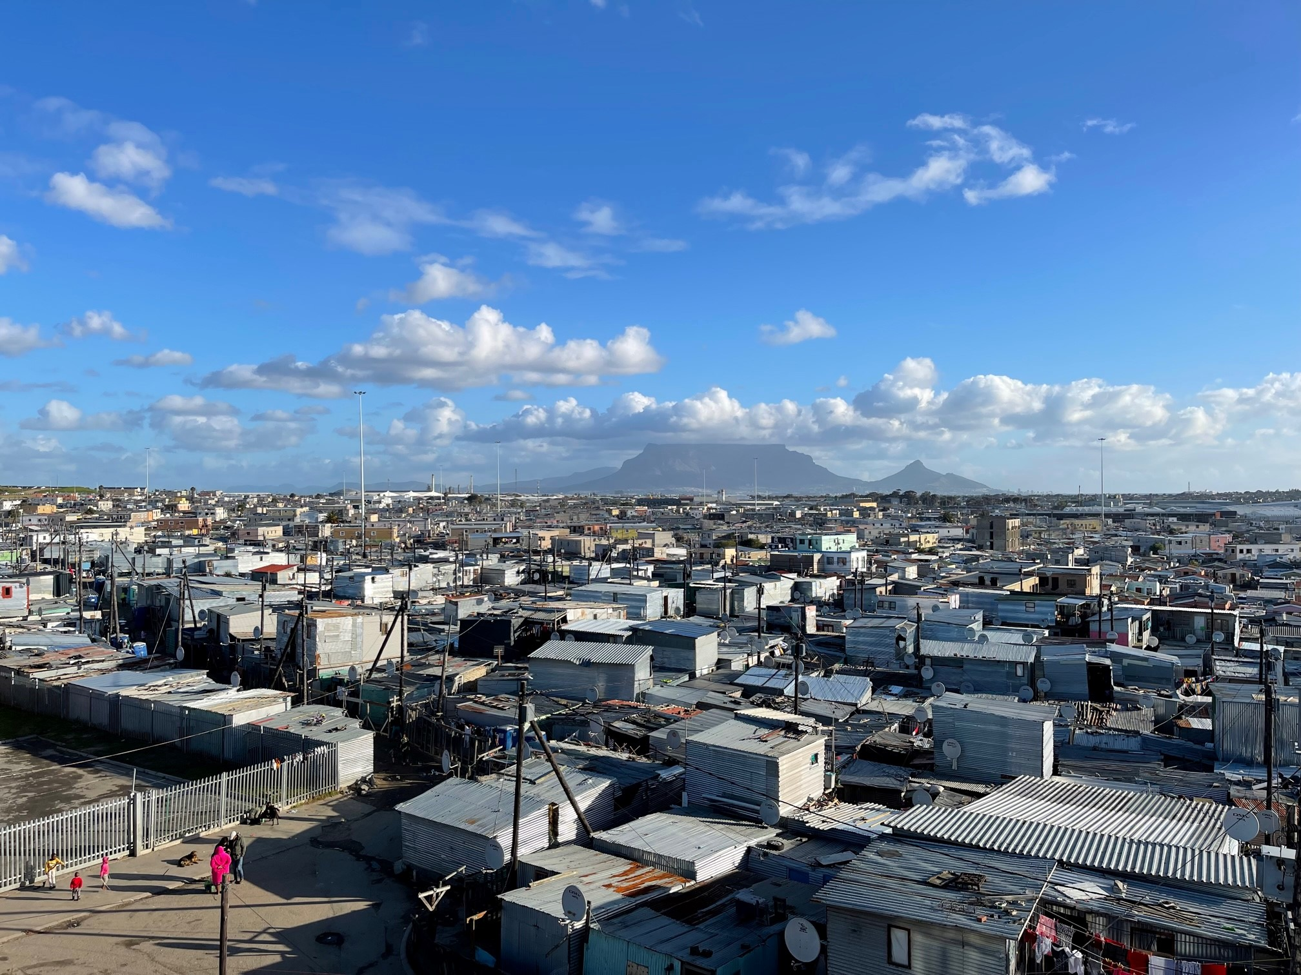

Slide 4
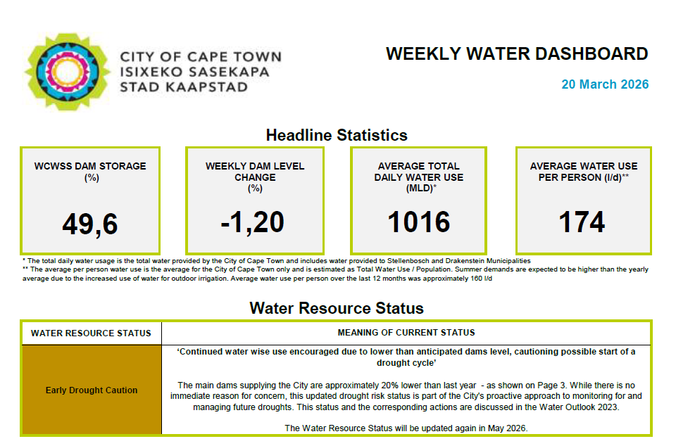

Slide 5
THE CRISIS
Cape Town 2015–2018: Three Years That Changed Everything
<20%
54%
50L
Dam storage at lowest point
Reduction in water consumption
Per person per day at peak restriction
2015–2017 Three consecutive years of record-low rainfall — the lowest in recorded history — drained the Western Cape dam system. Day Zero The concept named the threat: the day piped supply to homes would be cut off and residents would queue at collection points. It was the most powerful communication tool of the crisis.
The response Stringent restrictions, steep tariffs for high users, and pressure management cut daily consumption from 1,100 Mℓ to 500 Mℓ. The outcome Near-average rains in winter 2018 restored dam levels. Day Zero was called off. Cape Town had — just barely — averted catastrophe.
\

Slide 6
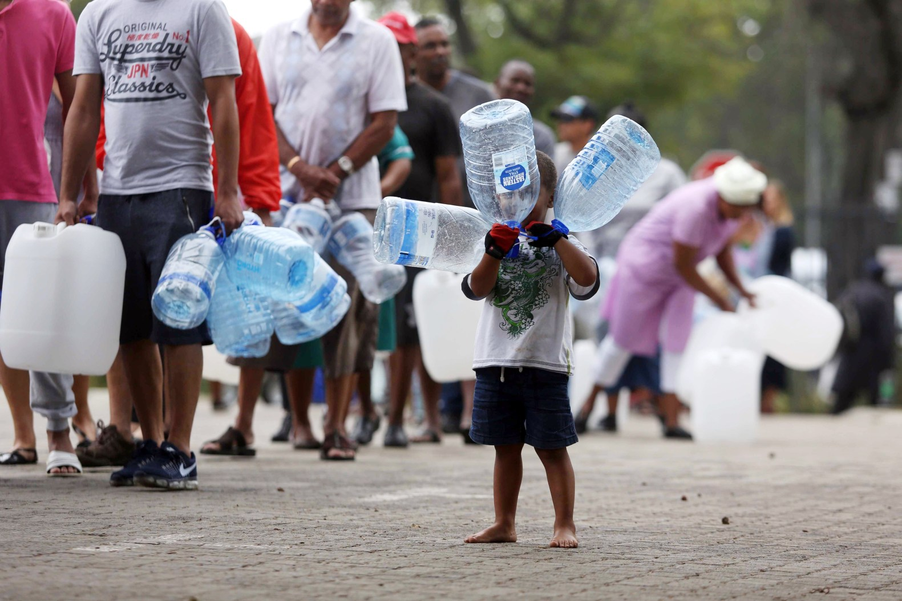

Slide 7
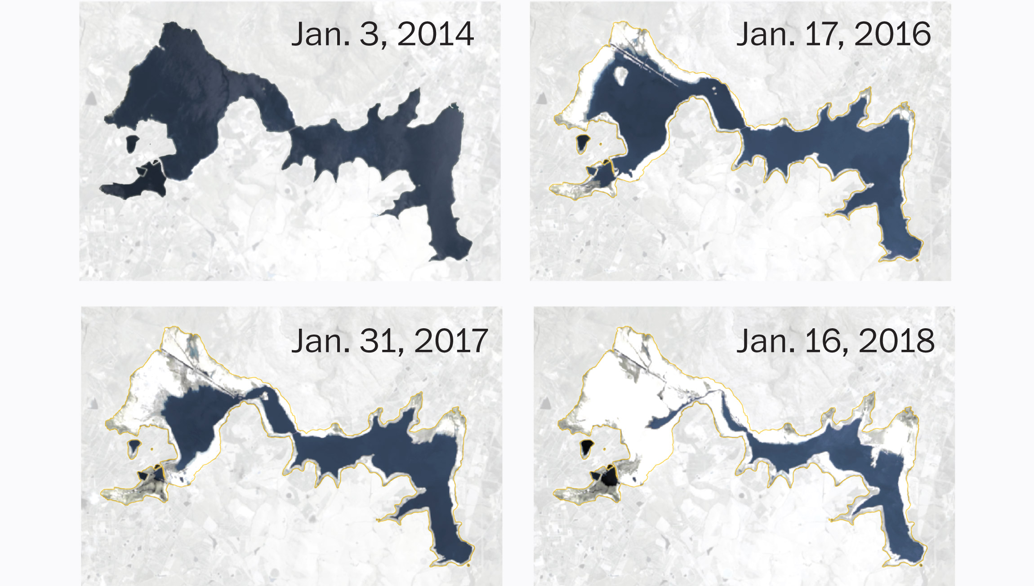

Slide 8
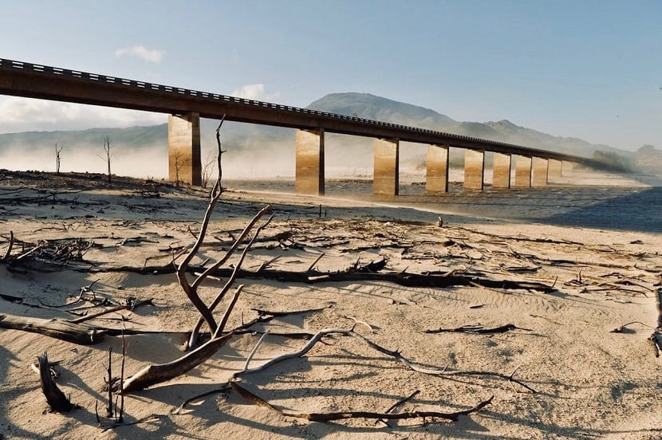

Slide 9
SO WHAT? WE HAVEN’T HAD A DROUGHT SINCE?

Slide 10
TRICKLING TOWARDS DAY ZERO
CURRRENT
2040
Surface Water
Groundwater
Desalination
Reuse

Slide 11
NEW WATER PROGRAMME

Slide 12
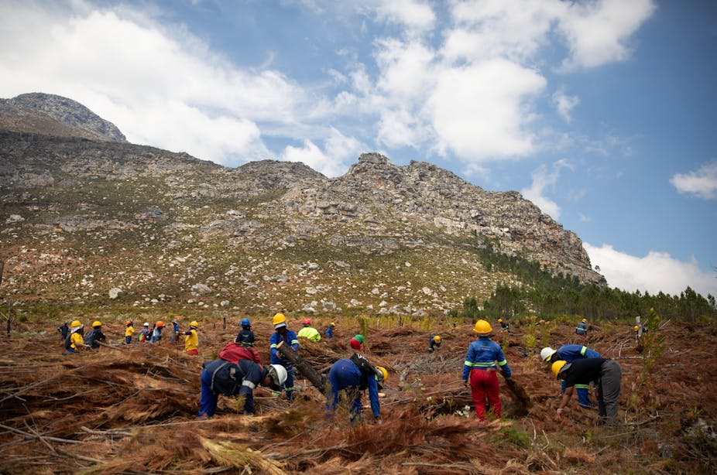

1. Alien Invasive Plant Removal
The removal of non-indigenous, water-guzzling plants is an important component of the City's Water Strategy and long-term New Water Programme, which aims to add 55 billion litres per year to the water network by 2026.

Slide 13
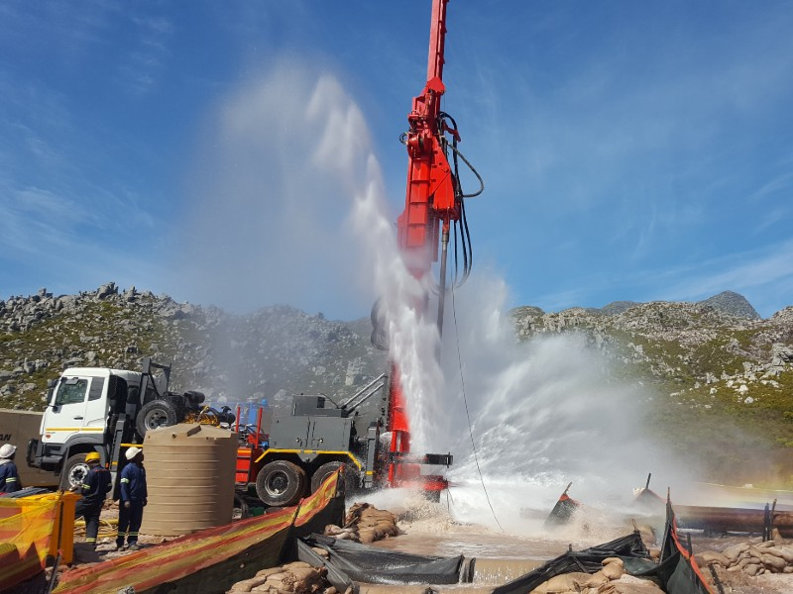

2. Responsible Groundwater Abstraction
Drilling boreholes and tapping into springs will secure over 105 million litres a day by 2036
Groundwater: Drilling boreholes and tapping springs securing over 100 million litres a day.

Slide 14
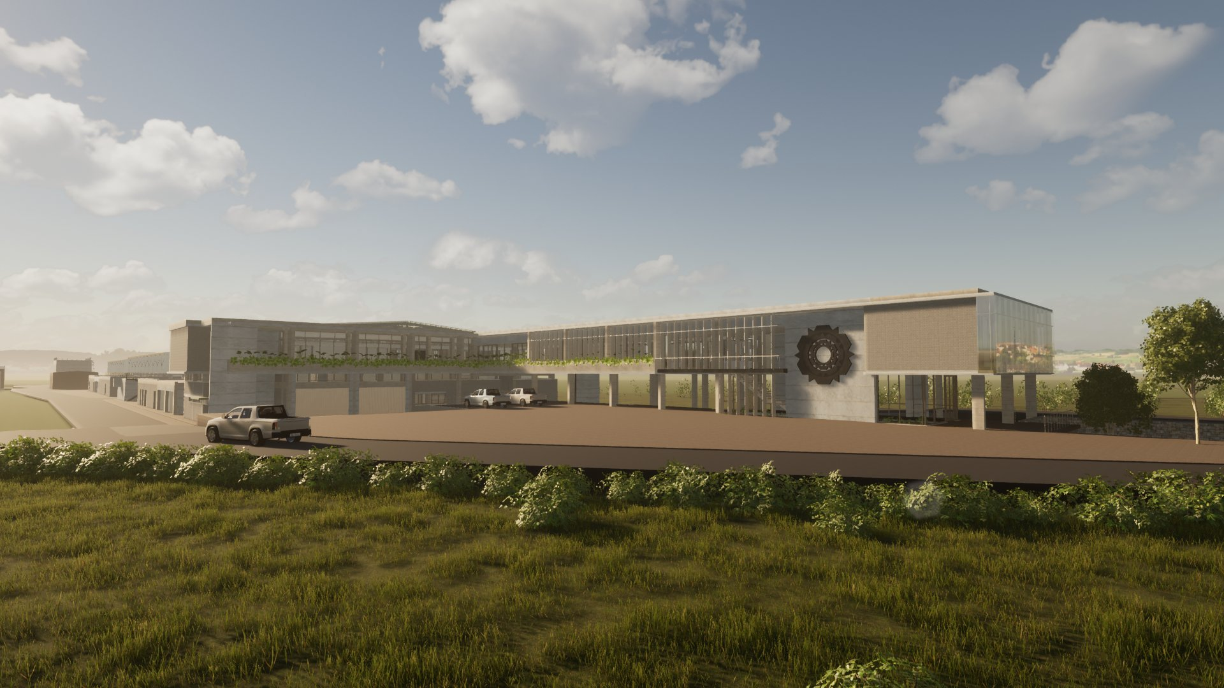
3. Water Re-use
Implementing purified recycled wastewater, adding 70 million to 100 million litres a day by 2031. This will be the largest reuse scheme on the African continent.

Slide 15
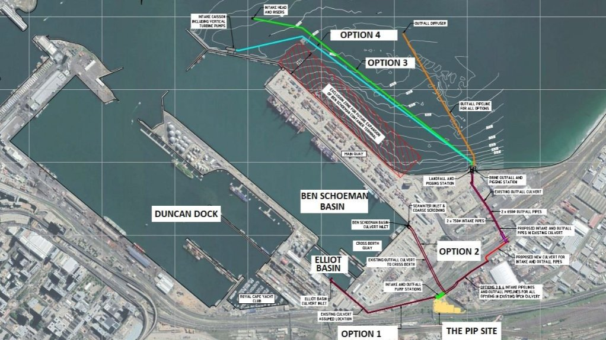
4. Desalination
Extracting salt from seawater to yield 50 million to 70 million litres a day.

Slide 16
What Advice Would We Give?
Act early
Trust your residents
Everything is harder, more expensive, and less effective when done under the pressure of a crisis already unfolding. Build the framework before you need it.
Treat people as partners, not problems. Communicate the truth, ask for their help, and they will surprise you with what they can achieve.
Diversify your sources
Institutionalise
No city that depends on a single water source is truly resilient. Rainfall cannot be your only plan. Invest in independence from climate variability.
Resilience must be built into governance, budget, and policy — not improvised when crisis arrives. Build frameworks that trigger action automatically.

