Slide 1
8th Session of the Global Platform
for Disaster Risk Reduction (GP2025)
Briefing on the Global Platform for Disaster Risk Reduction
8 April 2025

Slide 2
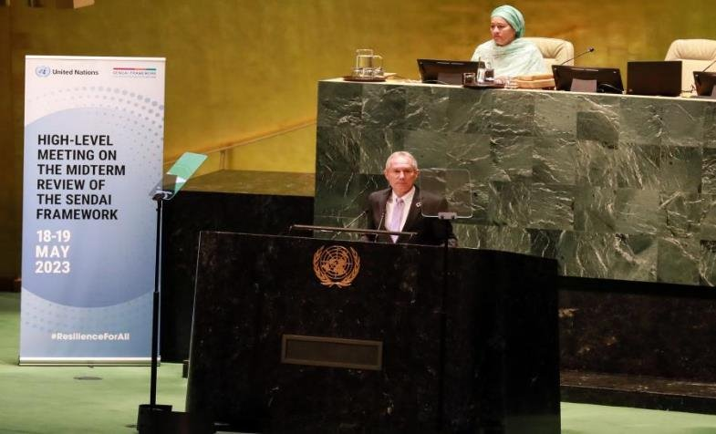
The Global Platform for Disaster Risk Reduction 2025
Background
Global forum, recognized by the UNGA, to assess, discuss and monitor progress on the implementation of Sendai Framework for Disaster Risk Reduction (DRR)
Frequency
Seven sessions since 2007
Held every 3 years (initially 2 years until 2019)
Stakeholder involvement
All-of-society approach including Governments, non-state stakeholders and the UN system
Organized and convened by UNDRR
“We look forward to the global and regional platforms for disaster risk reduction to be held before 2030 to assess and discuss progress on and give practical guidance to the implementation of the Sendai Framework, including on the implementation of the present political declaration.”

Slide 3
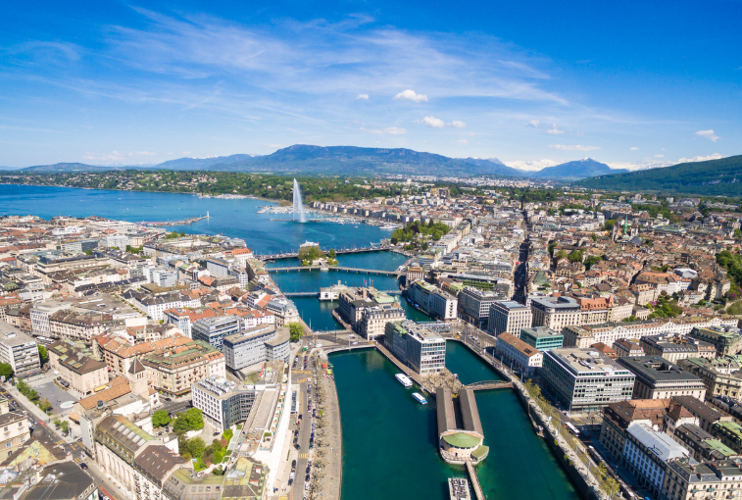
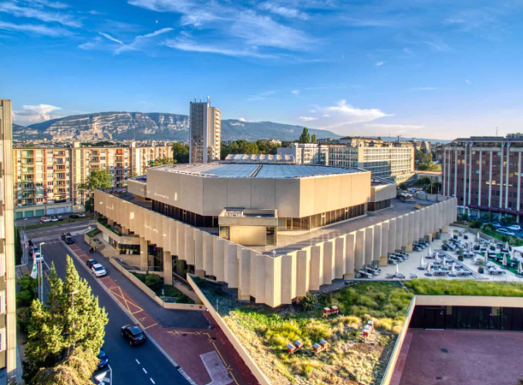
GP2025
Co-chair: SRSG Kishore, UNDRR and H.E. Patricia Danzi, Government of Switzerland
Overall Theme: "Every Day Counts, Act for Resilience Today"
Date: 2-6 June 2025
Opening Ceremony: 3 June
Venue: CICG and WMO in Geneva, Switzerland
Participants: 4000+ participants expected
Format: Hybrid

Slide 4
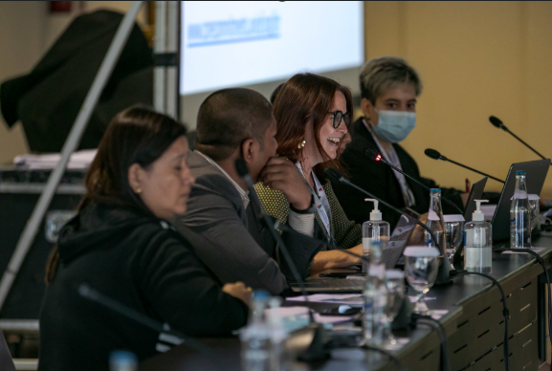
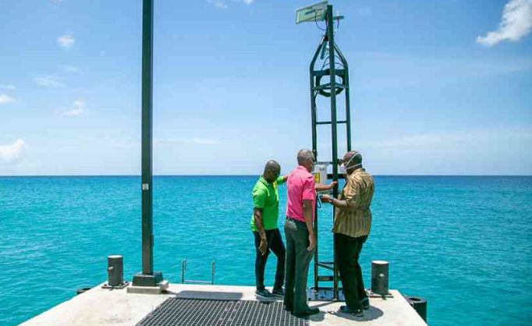
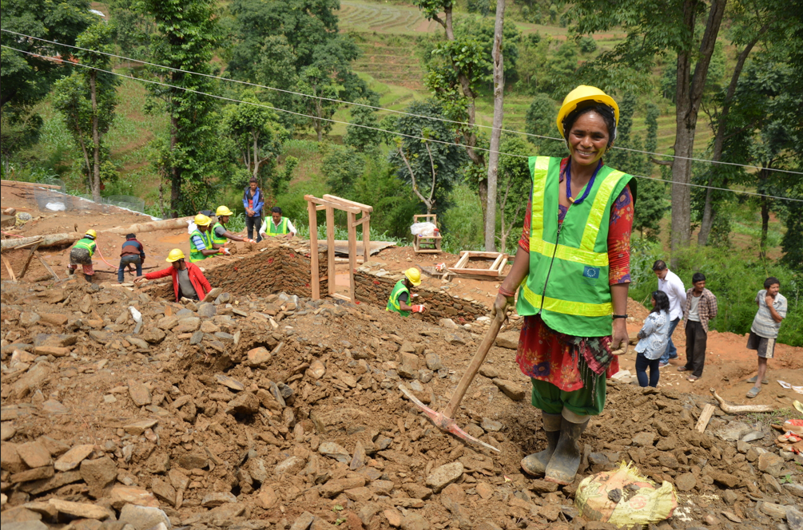
Preparatory Days (2-3 June 2025)
3rd Stakeholder Forum on DRR
2-3 June at CICG/CCV
Organized by Stakeholder Engagement Mechanism (SEM)
Provides avenue for showcasing inclusive, all-of-society approach to DRR
Global EW4ALL
Multi-stakeholder Forum
2-3 June at WMO bldg.
Co-led by WMO and UNDRR
Aims to accelerate actions for EW4ALL initiative and efforts to contribute to target G
World Resilient Recovery Conference (WRRC)
3 June at CICG/CCV
Organized under umbrella of IRP
Aims to catalyze global progress in preparing for and managing resilient recovery

Slide 5
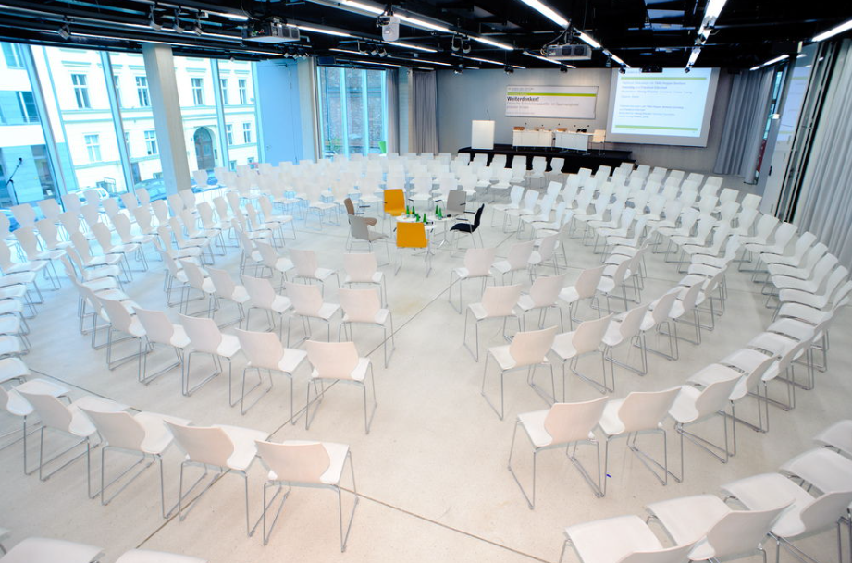
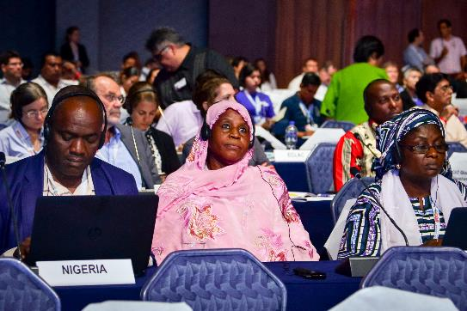
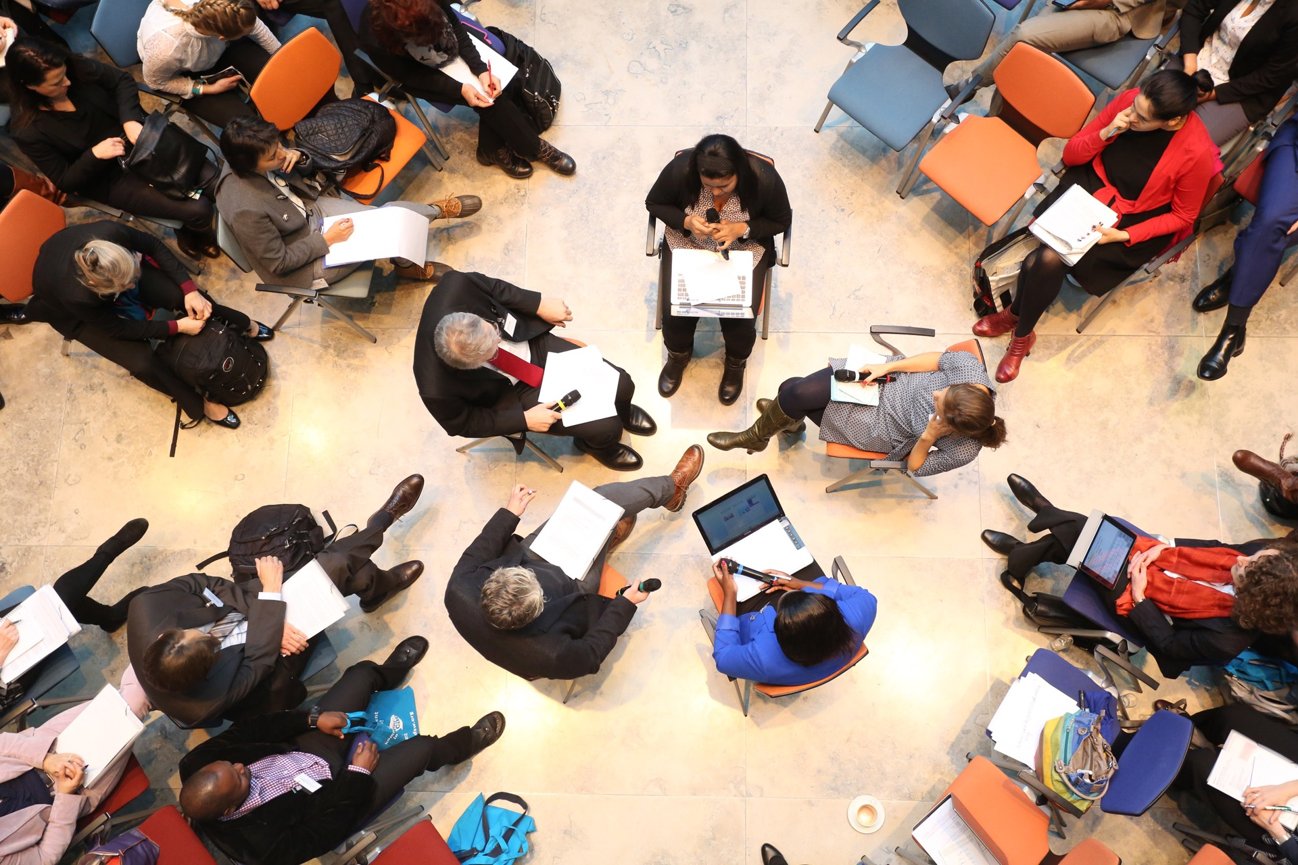
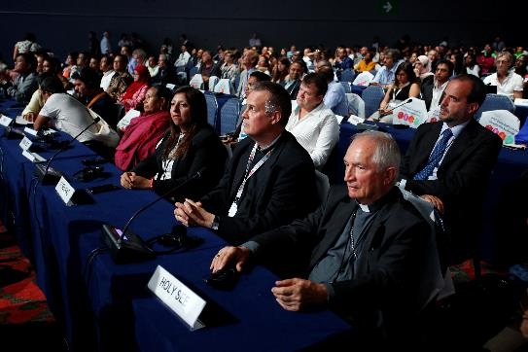
GP2025 Official Programme
4 High Level Dialogues & 15 Thematic Sessions and Special Sessions & Events for sharing experiences and accelerating Sendai Framework
Sessions are organized across each of the 4 priorities of the Political Declaration of the High-Level Meeting of the Midterm Review
At GP2025 regional and local bodies are recognized as central for effective governance and realizing the goals of the Sendai Framework
Multiple sessions on:
  Local and regional risk governance
  Urban resilience strategies and solutions
  Community led DRR
Picture
Picture

Slide 6
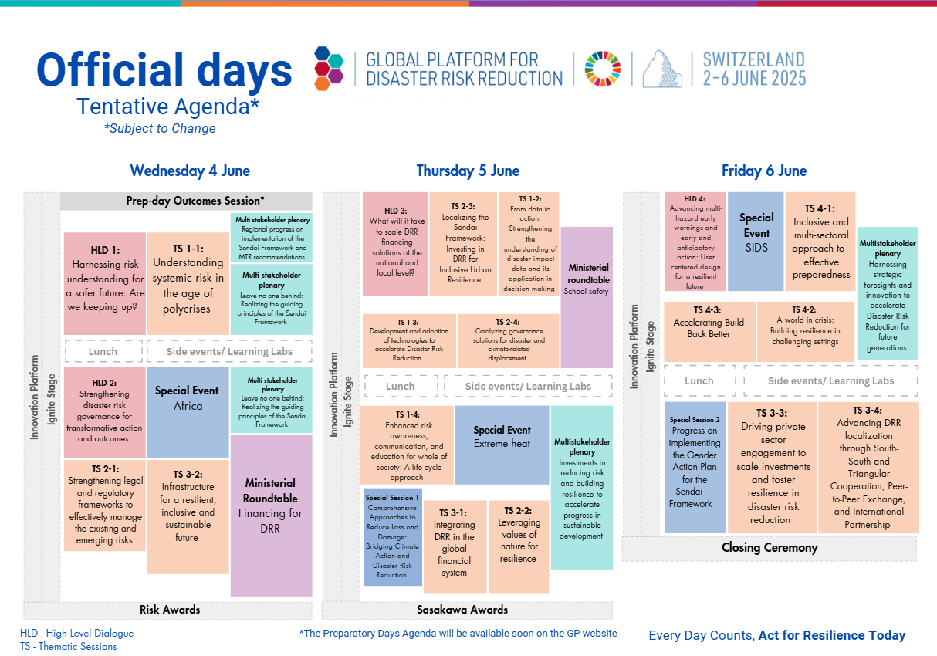

Slide 7
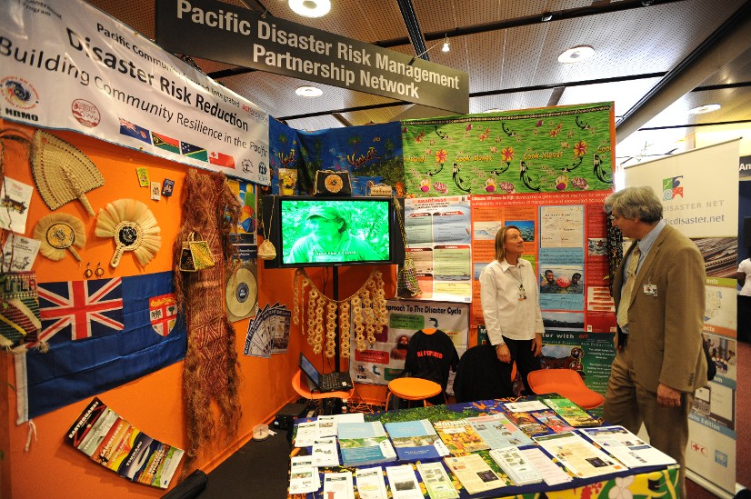
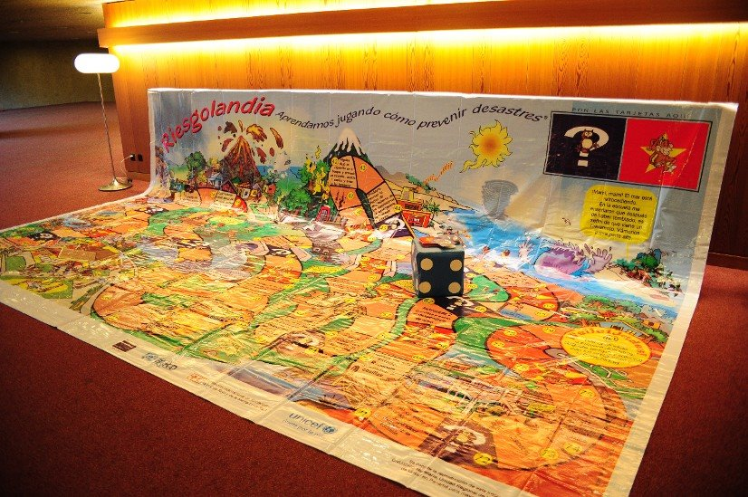
Informal Programme
Innovation Platform (27 selected)
  Showcases new applications, technologies, and innovative approaches in the DRR space.
Side Events (17 selected)
  Provides a platform for DRR actors to raise awareness, exchange knowledge, and build partnerships.
Ignite Stage (96 speakers selected)
  Features TED-talk-style presentations on DRR topics, projects, or initiatives.
Learning Labs (16 sessions)
  Interactive group sessions for peer-to-peer learning on specific DRR topics.
Notes:
Write updates on IP, Side Events, Ignite Stage all on one page (we include maybe include desription if space allows)
Include pics
Note: Use some information from P9

Slide 8
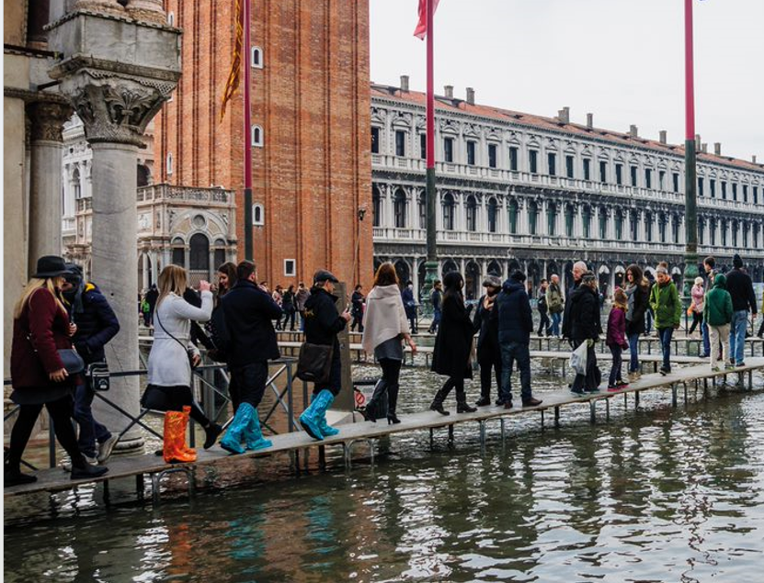
Potential outcomes
Fostering of city-to-city collaboration, networking, and learning
Collaboration and connection across sectors and levels of government
A renewed emphasis and focus on Local/Urban DRR and its place in the Sendai Framework
Strategies and success stories on unlocking local financing
Focus on local risk governance, planning, and risk-informed urban development

Slide 9
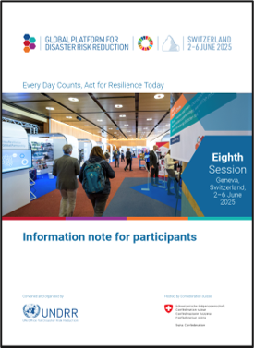
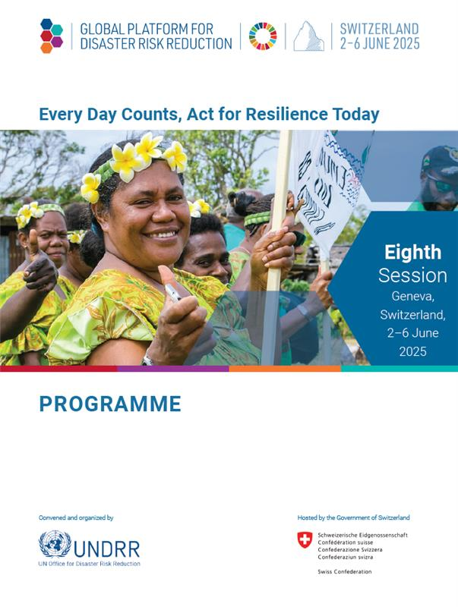
Practical Information
Register now online via Indico and receive your digital badge before 2 May https://indico.un.org/event/1013104/registrations/16829/
Hybrid conference and remote participation is possible
Arrange travel and hotel accommodations
For more information, please check the GP2025 Infonote on the GP2025 website
Notes:
Key actions (maybe merge with P12)
-Register through indico
Submit to LDCs SIDs
Travel support
Compositions

Slide 10

Thank you!

